Slide 1
The Transformation to Whole Health:
The National Need and
the Opportunity for Virginia Tech
Tracy Gaudet, MD
Former Executive Director, Whole Health Institute
Former Executive Director, Office of Patient-Centered Care and Cultural Transformation,
Veterans Health Administration

Slide 2
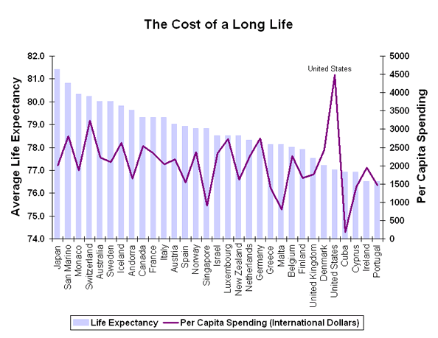
The Global Economics and Outcomes
UC Project for Global Inequality

Slide 3
The Healthcare Crisis Facing the U.S.
Healthcare consumed 19.7% of our GDP in 2020 and costs continue to rise, with unsatisfactory results.
Life expectancy decreased to 77 years in 2020 and 76 years in 2021 representing the biggest two-year decline since 1921-1923.
Chronic conditions consume more than 75% of health care costs, are largely affected by people’s choices and behaviors.
Heart disease remains the #1 killer of Americans and changing lifestyle could prevent at least 90% of all heart disease. (Lancet. 2004 Sep)

Slide 4
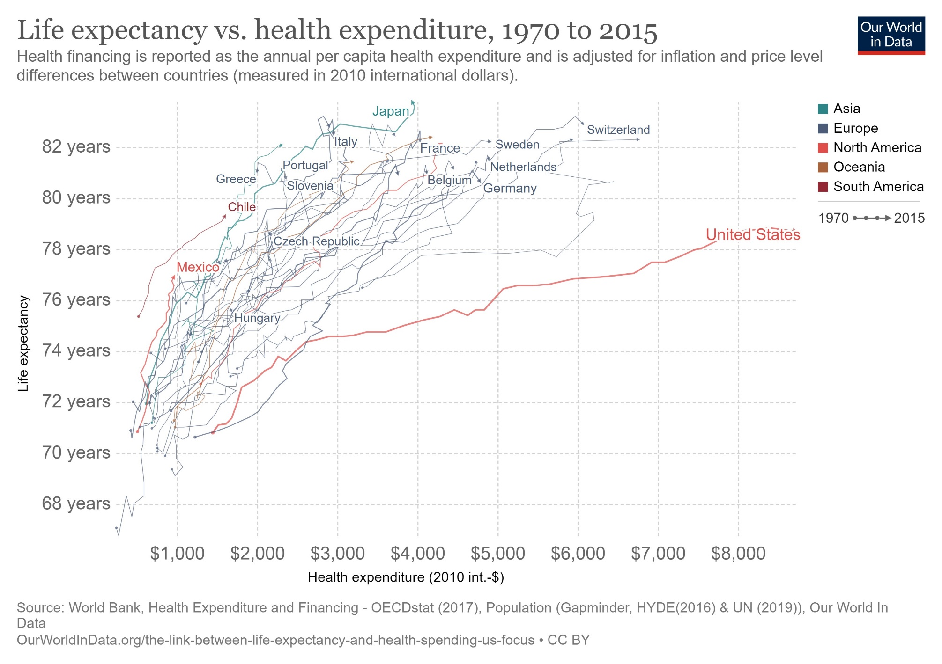
https://ourworldindata.org/the-link-between-life-expectancy-and-health-spending-us-focus

Slide 5
Doing more of the same
will not
fix this problem.

Slide 6


Problem Number One
The current health care model doesn’t work because it is designed to diagnose and treat disease.
It does not have a core competency in engaging people in
optimizing self-care and well-being.

Slide 7
Science and Medicine
1900s
2000s
    Germ Theory
    Chemistry
    Physiology
    Pathology
    Newtonian Physics
Genomics
Proteomics
Metabolomics
Systems Biology
Quantum Physics
Informatics
Find It
Fix It
Predict It
Personalize It
Understanding Disease
Understanding Health,
Disease and Complexity
©2013 RALPH SNYDERMAN
Ralph Snyderman, M.D. Duke Health System
Notes:
11/22/2022

Slide 8
Our Understanding of Health & Disease
1900s Reductionism:
  Single factor causes disease.
  Resulted in “find-it, fix-it” disease care approach.
2000s Systems Approach: Multiple Factors
  Complex Adaptive Systems: Genomic risk, environmental factors, social determinants, and lifestyle choices.
  This calls for a new approach –
  in healthcare, in communities, in workplaces, and in research.

Slide 9
“Problems cannot be solved
by the same level of thinking
that created them."
Albert Einstein

Slide 10
Reductionistic Approach | Systems Approach
Focused on disease | Focused on the person and their purpose
Problem based | Aspiration based
Physician-directed | Partnership with team
Disease management | Health optimization
Find it, fix it | Identify risk, minimize it
Reactive | Proactive
Sporadic | Lifelong planning
Biomedical interventions | Whole person approaches
Individual left to enact | Skill building and support in the workplace and community

Slide 11
Some of the Systems that
Impact Health and Well-Being
Healthcare Systems
Employers
Communiities
Education
Health Finance and Policy
Spiritual Communities
Childhood Experiences
Food and Nutrition
Technology and Innovation
Research Communities
Big Pharma and Biotech
Government (local, state, federal)
Nonprofits and Advocacy Groups

Slide 12
Problem Number Two
Even if healthcare DID have a core competency
in engaging people in
optimizing self-care and well-being…

Slide 13
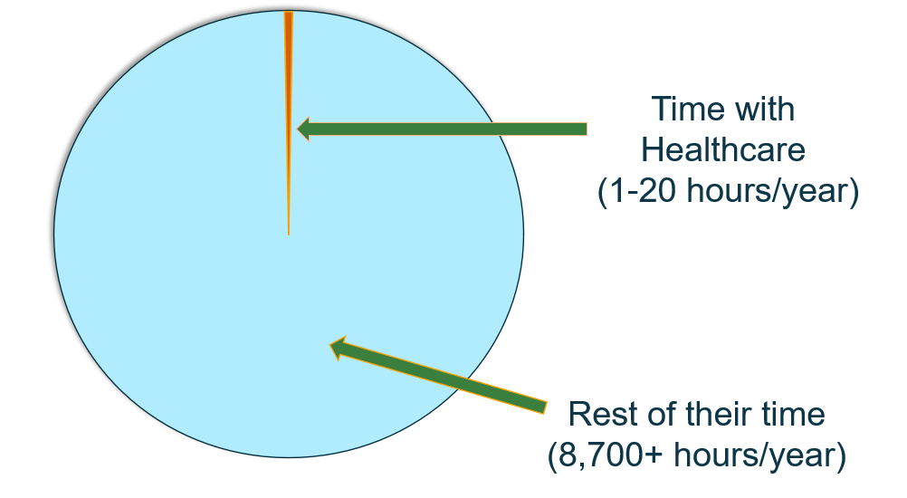
How “Patients” Spend Their Time
13
Notes:
An illustration of the point in question 2. The tiny sliver is not a lot of their time each year to promote behavior change.

Slide 14
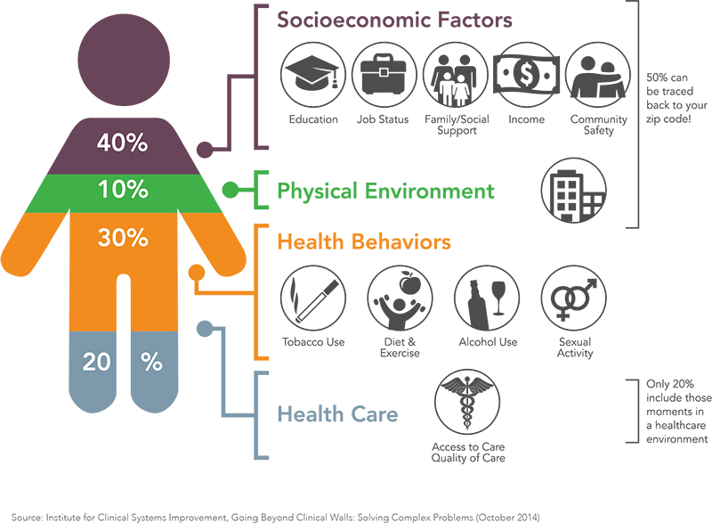
14

Slide 15

Problem Number Three
Current behavior change efforts that are attempting to drive
self-care and well-being don’t work

Slide 16
Behavior Change Efforts to Drive Self-Care & Well-being
Employee Wellness Programs
  Over 80% of large employers offer programs designed to optimize health behaviors – touching over 50 million U.S. workers
    50% of companies offer biometric screening
    Over half offer incentives, with 18% tied to specific biometric targets
    30% collect data on employee through apps and wearables
With insignificant effects
  Limited data but research so far indicates insignificant effects on:
    Total medical expenditures, health behaviors, employee productivity, or self-reported health status over the long term (more than two years).
    Where there appear to be benefits, it is in primarily higher-income employees with lower health risks

Slide 17
The Core Issue:
We Are Starting from the Wrong Place

Slide 18
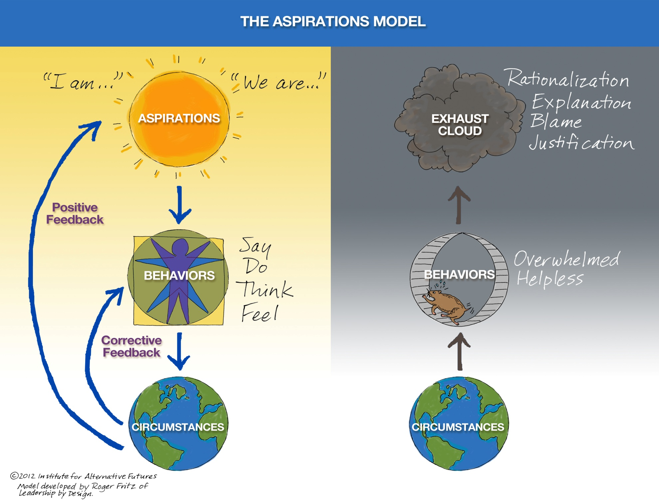
Roger Fritz, “The Aspirations Model.” St. Louis: Leadership by Design, 1990.

Slide 19
Purpose in Life = Longer Life
7,100+ American adults followed for 15 years
Self-rated on three statements:
  Wandering through life
  Thinking about the future
  Feeling there is still more to do in life
Regardless of age, relationship status, depression or other factors...
...There was a survival benefit for people who felt in general that they had purpose. Imagine connecting that to health even more intentionally!
Hill, Psychol Sci, 2014; 25(7):1482–6.
Notes:
Note that for every study we cover, we know different people will want to go more or less in depth into the research. There will typically be summary boxes that can cover the fundamentals of the study, for those who don’t want detail. There is also a reference for each study, for those who want to dive even deeper.
The 3 questions in full form were confusing to people, so we simplified them from these:
Some people wander through life, but I am not one of them. (positive answer better)
I live one day at a time and don’t really think about the future (negative answer better)
I sometimes feel as if I have done all there is to do in life (negative answer better)
Abstract:
Having a purpose in life has been cited consistently as an indicator of healthy aging for several reasons, including its potential for reducing mortality risk. In the current study, we sought to extend previous findings by examining whether purpose in life promotes longevity across the adult years, using data from the longitudinal Midlife in the United States (MIDUS) sample. Proportional-hazards models demonstrated that purposeful individuals lived longer than their counterparts did during the 14 years after the baseline assessment, even when controlling for other markers of psychological and affective well-being. Moreover, these longevity benefits did not appear to be conditional on the participants' age, how long they lived during the follow-up period, or whether they had retired from the workforce. In other words, having a purpose in life appears to widely buffer against mortality risk across the adult years.

Slide 20

There is nothing in the world,
I venture to say,
that so effectively helps one to survive even the worst conditions as the knowledge that there is a
meaning in one’s life.
(Victor Frankl, Man’s Search for Meaning)
Photo: Adam Rindfleisch

Slide 21
Does Meaning and Purpose Impact Health?
A stronger purpose in life was associated with decreased mortality
N=6985
“Association Between Life Purpose and Mortality Among US Adults Older Than 50 Years” Original Investigation by Aliya Alimujiang, MPH et al JAMA Network Open. 2019;2(5):e194270. doi:10.1001/jamanetworkopen.2019.4270

Slide 22
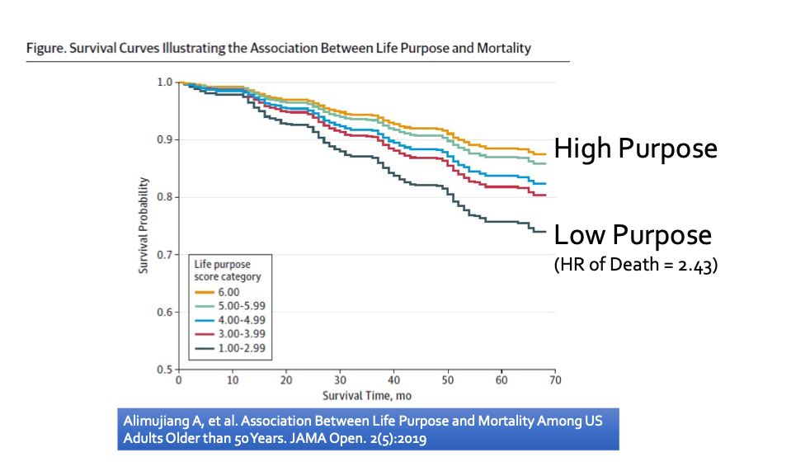

Slide 23

What do you live for?
What is your Great WHY?

Slide 24
And what is possible when your purpose becomes
the driver of your well-being?
Couple this with skill building and support
to address your self care,
so that you can live a full and meaningful life….
And watch hope and magic begin.

Slide 25
Whole Health
empowers and equips people
to take charge
of their physical, mental and spiritual health
to live a full and meaningful life.

Slide 26

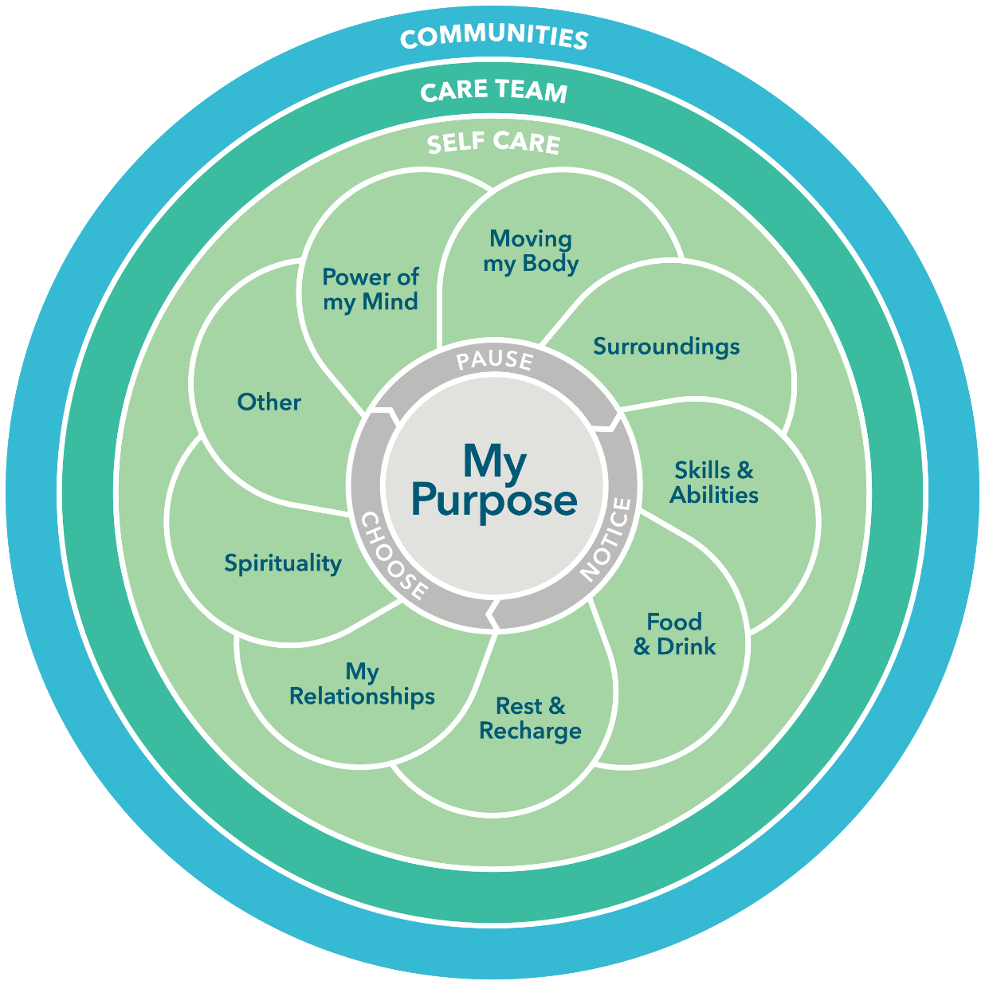

Slide 27
What Does a System Look Like if it is Designed for This?

Slide 28
Whole Health is a transformation of individual behaviors and the systems that impact health and well-being.
Its purpose is to achieve significantly better health outcomes at much lower human and financial costs, BY
Empowering and engaging people to take charge of their own health, supported by peers and community.
Equipping people with the skills of self care with the support of instructors and coaches, reinforced by peers and community.
Treating people with clinical and interprofessional teams that are skilled in the science and art of Whole Health and enable every individual to take charge of their health and disease.
Connecting people to each other, to peers and in community.

Slide 29
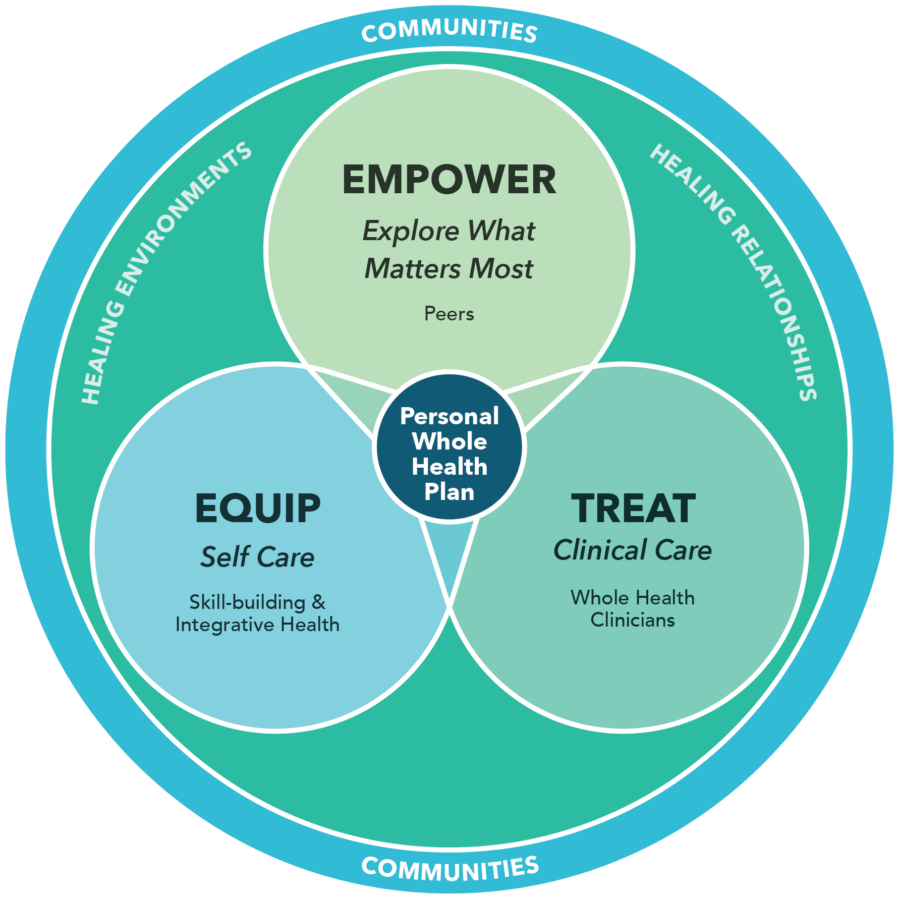
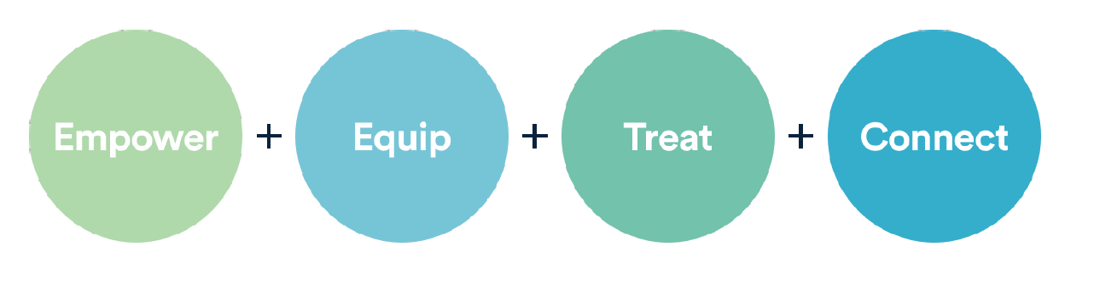
The
Transformed Health
System

Slide 30
Empower – Finding Your Purpose
Led By Peers
An opportunity for self-exploration around purpose, meaning and what matters most, and share through storytelling
Introduction to Whole Health classes and Taking Charge of my Life and Health program to empower individuals and their families

Slide 31
Equip – Self Care
Led by Instructors & Coaches
Well-Being focused activities, skill building classes and support, Whole Health coaching - provide experiences around the Circle of Health
Power of the Mind; Moving the Body; Surroundings; Skills and Abilities; Food & Drink; Rest and Recharge; Relationships; Spirituality; Other

Slide 32
Treat – Clinical Care
Led by Clinicians, trained in Whole Health
Whole Health Shared Medical Appointments (SMA) focus on optimizing health and well-being and co-creating a personal health plan (PHP) which serves as their overarching plan
Providers aligned with Whole Health - MD, DO, ND, NP, Lifestyle Medicine, Integrative/functional nutritionists, mental health professionals, coaches, others

Slide 33
Community – Connect
  Led by ALL
  Where we live and work
  Support and belonging
  Our interdependence
  Well-Being is rooted in and sustained by community

Slide 34
Transformation,
NOT incremental improvement, is required because:
Healthcare costs are high and getting higher.
Health outcomes are poor and getting worse.
We are not getting the value we should,
and that other nations are getting,
for the resources we are investing.
The human toll of an unhealthy population is
an avoidable tragedy.

Slide 35
A Relevant Example in
Driving Large System Transformation
The VA is taking a systems approach – addressing each of the following efforts synergistically:
  Created a new model of healthcare
  Developed detailed implementation guide and dashboard
  Provided experiences and education for the workforce
  Researched the implementation and the outcomes
  Changed the Veterans benefits package
  Aligned how leadership is evaluated

Slide 36
Does it Work?

Slide 37
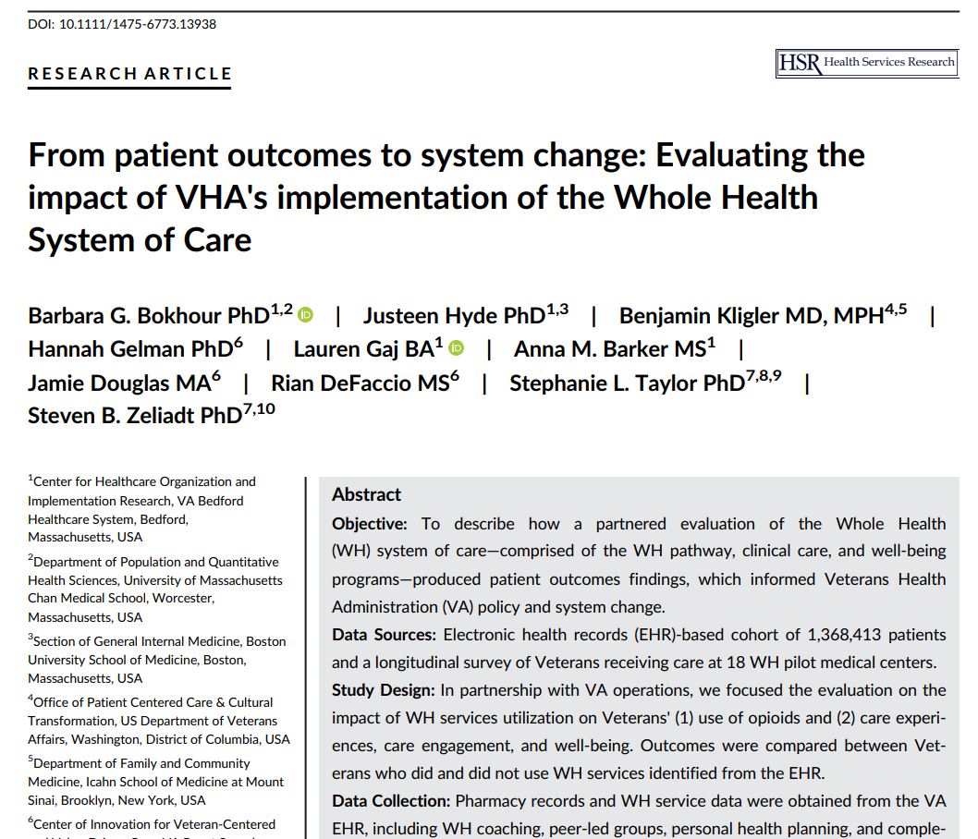

Slide 38
Initial Research Findings Across 18 Health Systems in the Veterans Health Administration
  For the Veterans: A three-fold reduction in opioid use, increased perception of care, engagement in their care and their selfcare, engagement in life, and decreased stress.
  For Employees: Decreased burnout, increased motivation, and reduction in resignations for physicians, nurses and other health services employees
  For the Facilities: Increased hospital performance and increased ratings for patient-centered care
  Outpatient costs: Smaller increases in pharmacy costs (4.3% vs 15.8%) with Veterans with chronic conditions and mental health conditions (3.5% vs 12.5%)
Bokhour, B., Hyde, J. et al., From patient outcomes to system change: Evaluating the impact of VHA’s implementation of the Whole Health System of Care. Health Serv. Res. 2022: 1-13.

Slide 39
Whole Health Outcomes across 18 V.A. Health Systems
  There was a threefold reduction in opioid use among patients with chronic pain who used the Whole Health System services compared to those who did not (38% decrease vs 11%)
  Which group showed the greatest impact?
    The people focused on complementary and integrative services?
    The people focused on peer and coaching services?
    The people who did both?
Bokhour, B., Hyde, J. et al., From patient outcomes to system change: Evaluating the impact of VHA’s implementation of the Whole Health System of Care. Health Serv. Res. 2022: 1-13.
Notes:
Key summary points:
WH had a + impact on reducing opioid use
3 fold reduction in opioid use among Veterans with chronic pain who use WHS services compared to those who did not
Overall opioid use decreasing amongst Veterans; however comprehensive WH users decreased opioid use by 38% compared to 11% decrease amongst Veterans with no WH use
Veteran reported outcomes
Gathered from the Veteran Health & Life Survey conducted at flagship sites to learn about Veteran perceived changes in health and well-being when receiving WH services.
Survey assesses range of patient reported outcomes(Veteran experiences of care, engagement, meaning and purpose, pain and physical and mental health)
Veterans surveyed at baseline, 6 month and 12 month timepoints. Findings for 12 month time point not available (As of Jan 2020)
N=3266 Veterans completed baseline and 6 month survey. Survey is ongoing with anticipated participation of 10,000 Veterans across 18 flagship sites
Compared to Veterans who did not use WH services, Veterans who used WH services reported:
Greater improvements in perceptions of the care received as being more patient-centered.
Greater improvements in engagement in healthcare and self-care.
Greater improvements in engagement in life indicating improvements in mission, aspiration and purpose.
Greater improvements in perceived stress indicating improvements in overall well-being.

Slide 40
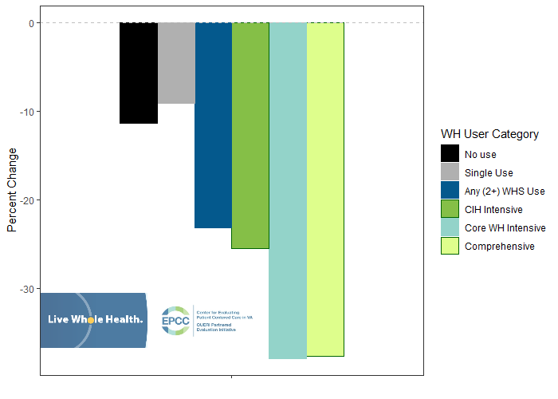
V.A. Whole Health Implementation Opioid Utilization
Change in opioid use by WH user category for Veterans with chronic pain (n=114,357)
Data Source: EPCC – Department of Veteran Affairs

Slide 41
Where is the greatest Impact?
Research Groups
  No Use: No Whole Health use
  Single Use: 1 Whole Health service
  Any 2+ Use: More than 2 Whole Health services
  CIH Intensive:
    Any peer or coaching services; More than 4 Complementary and Integrative Health (CIH) services, including:
      Chiropractic care, Massage, acupuncture & Battlefield acupuncture, Yoga, Tai Chi, Meditation, Biofeedback, Guided Imagery, Hypnosis
  Core WH Intensive:
    Any CIH service and 4+ peer or coaching services, including:
      Personal Health Planning
      Peer-led Groups
      Whole Health Coaching
      Whole Health Educational Groups
  Comprehensive WH:
    More than 8 Whole Health services:
      2+ peer or coaching services
      2+ CIH services

Slide 42
The good news:
Whole health approaches such as peer programs
do not need to be
within the clinical setting.
We believe they are best offered where people
live, work, and learn.

Slide 43
“Whole Health began my journey to joy, I am a changed person. I no longer need my cane. The Whole Health group has become my family. My neurologist says he doesn’t need to see me anymore!”
“I have lost 33 pounds. I go to FIT class, nutrition class, Battle-field acupuncture, and regular acupuncture. My wife says I have a positive attitude now! And my diabetes is under control, blood pressure down and lipids good. I see my primary care doctor much less”
52 year old Male
71 year old Male
“I used to drive over the Mississippi River Bridge, to Jefferson Barracks VA, and think about jumping every time. The whole health system has helped me explore my purpose, find ways to use nutrition to reduce my pain, and use iRest and Tai Chi to get moving again. Now I drive over that bridge and think about tomorrow…. I have hope”
37 year old Female

Slide 44
This transformation will not be driven by healthcare systems alone.
It will take a University with a bold, broad vision.

Slide 45

The Academic Consortium for Integrative Medicine and Health
Began in 1999 with 8 academic medical institutions
    Duke, Harvard, Stanford, UCSF, U of Arizona, U of Maryland, U of Massachusetts, U of Minnesota
Now more than 75 academic medical centers and health systems
But where is the leadership outside of the academic medical centers???

Slide 46
The Opportunity for Virginia Tech
The national need for transformation is clear.
The gap is also clear – heath systems alone cannot drive this.
You have a bold, broad vision with support from the top.
You have incredible faculty ready to make this a reality.
Systems thinking across your University can lead the nation.

Slide 47
The focus?
Where we live, work and learn.
The Approach?
A systems approach –
all systems impacting
health and well-being.

Slide 48
What Does Success Look Like?
Increased physical and mental well-being (decrease in pain, obesity, depression, and chronic conditions)
Increase in self-care
Decrease in clinical and pharmaceutical needs and decreased healthcare costs
Increase in employee engagement and business productivity
Increase in people’s sense of meaning and purpose, connectivity, compassion, and collective humanity
A transformation in social consciousness and a quantum leap in health and well-being

Slide 49
“The greatest barrier to discovery is not ignorance,
but the illusion of knowledge.”
David Borstein

Slide 50
Dream Rangers Video

