Slide 1
Using Amazon’s Mechanical Turk (MTurk) for Human Subjects Research
Aaron M. Ogletree, phd
NIH/NIMHD

Slide 2
Guiding Questions
What is MTurk?
What are some practical considerations for planning a study using MTurk?
How might MTurk participants differ from community-based samples?

Slide 3
What is MTurk?
Online crowdsourcing portal
Human Intelligence Tasks (HITs)
Originally used for manual tasks that require human responses, such as categorizing images for search engines
Now also used for human subjects research
Affordable
Quick
“Global, on-demand, 24x7 workforce”

Slide 4
Number of MTurk Publications by Year*
*Retrieved from PubMed on 26 January 2021 using search: “Amazon’s Mechanical Turk” OR “MTurk”

Slide 5
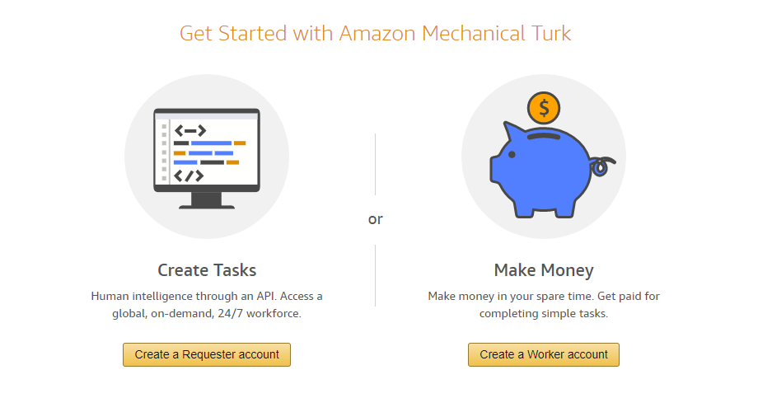
What is MTurk?
MTurk features that are helpful for researchers:
Specify “Worker” qualifications, or characteristics
Options include Age, Marital Status, Primary News Source, and Geographic Location
Set remuneration amount
HITs reward as little as $0.01
Identify desired number of survey respondents
500,000 registered users
15,000 users available at any given time

Slide 6
Practical Considerations?
Timing matters.
When is your sample likely to be accessing MTurk?
Consider time zone, days of the week, and time of day
Timing of posting: mutually exclusive HITs or overlapping postings?
Remuneration matters.
More $$$, Less problems!
Quality assurance matters.
Attention checks, data screening, and data integrity are all IMPERATIVE.
Recommend conducting a pilot study prior to full data collection.
Notes:
Our study found that time to recruit for each HIT had an inverse relationship with remuneration amount:
It took 1.5 hours to recruit 50 participants using $1.00 remuneration amount BUT
It took 487 hours to recruit 34 participants using a $0.10 payment amount

Slide 7
 | Weekday morning | Weekday evening | Weekend day
$0.10 | 9 n=34 SC: M=8.07 (SD=3.54) TTR: 20d 6h 48m (486h 48m) Cronbach’s α: 0.84 | 8 n=32 SC: M=7.77 (SD=3.61) TTR: 16d 20h 26m (404h 26m) Cronbach’s α: 0.89 | 7 n=34 SC: M=10.76 (SD=11.06) TTR: 5d 19h 32m (139h 32m) Cronbach’s α: 0.85
$0.50 | 5 n=43 SC: M=8.98 (SD=7.5) TTR: 5h 30m Cronbach’s α: 0.80 | 4 n=49 SC: M=7.67 (SD=2.93) TTR: 4h 22m Cronbach’s α: 0.89 | 6 n=43 SC: M=8.55 (SD=3.61) TTR: 6h Cronbach’s α: 0.84
$1.00 | 3 n=48 SC: M=8.38 (SD=3.9) TTR: 1h Cronbach’s α: 0.82 | 2 n=48 SC: M=7.75 (SD=2.39) TTR: 1h 34m Cronbach’s α: 0.91 | 1 n=50 SC: M=8.44 (SD=2.65) TTR: 1h 35m Cronbach’s α: 0.87
Note. n = total effective sample size from HIT; SC = average survey completion time per user (minutes); TTR = time needed to recruit n; Cronbach’s alpha from CES-D

Slide 8
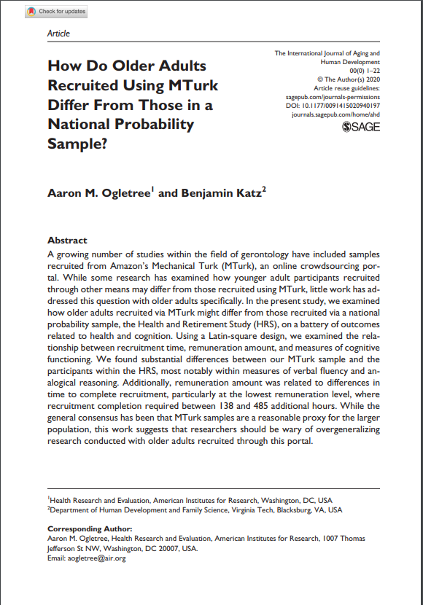
MTurk vs. Community-Based Samples?
Compared to 17,957 participants from the Health and Retirement Study, our 381 MTurk participants:
Were more depressed
Had better self-rated memory and self-rated health
Performed better on cognitive outcomes

Slide 9
Review
What is MTurk?
What are some practical considerations for planning a study using MTurk?
How might MTurk participants differ from community-based samples?

Slide 10
Thank you!
Aaron M. Ogletree, PhD
NIH/NIMHD
Email: ogletreeam@mail.nih.gov

