Slide 1
Finding and Understanding Funding Opportunity Announcements
Jose F. Ruiz, PhD, PMP
Director, NIH Guide to Grants and Contracts

Slide 2
Learning Objectives
Upon completion of this session, participants will be able to:
Find funding opportunity announcements (FOAs) of interest
Navigate a FOA efficiently to identify all the elements required to submit a responsive, compliant, and complete application.

Slide 3
Fundamentals of Funding Opportunity Announcements (FOAs)

Slide 4
What is a FOA ?
A publicly available document by which a Federal Agency (such as NIH) makes known its plans to award grants or cooperative agreements
A FOA contains information on key dates, individual and organizational eligibility, application and submission requirements, scientific area(s), review criteria, award administration, and agency point-of-contact information.
Organization and content of FOA is defined by the Office of Management and Budget (OMB)

Slide 5
What type of FOAs are available?
Parent Announcements – Trans-NIH; broad FOAs for investigator-initiated research for a specific activity code
Program Announcements (PAs) – One or more NIH ICs; highlight areas of scientific interest; transitioning to NOSIs and Parent Announcements – expect gains in efficiency and focus on science. Subtypes:
PAS (with set-aside funds)
PAR (with special receipt, referral, and/or review considerations
Requests for Applications (RFAs)– One or more NIH ICs; highlight well-defined area of science

Slide 6
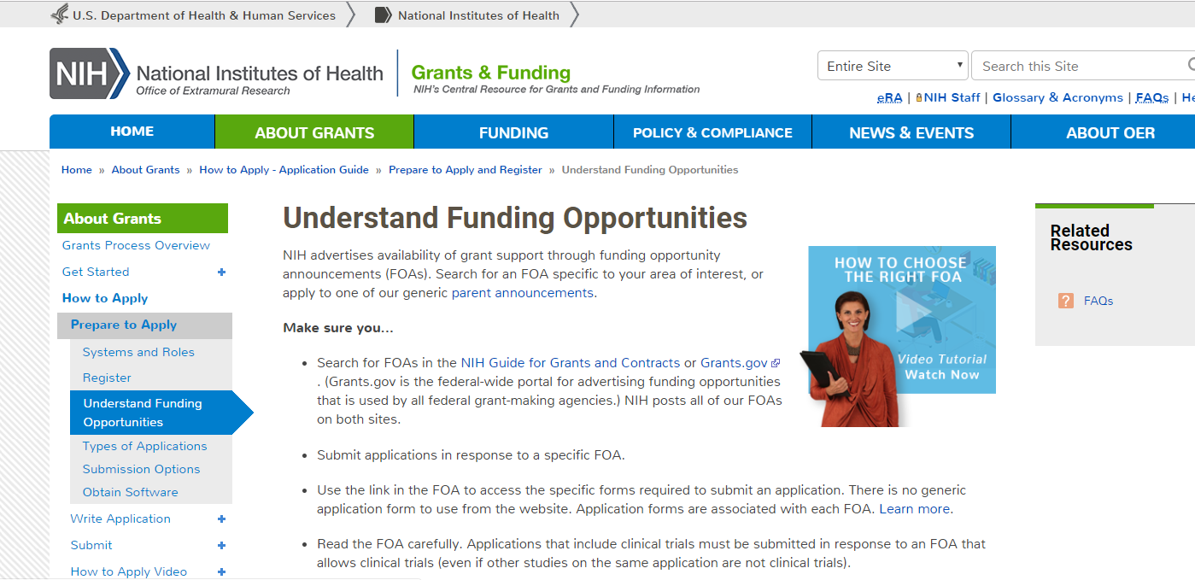
For more information on FOAs, please visit: https://grants.nih.gov/grants/how-to-apply-application-guide/prepare-to-apply-and-register/understand-funding-opportunities.htm

Slide 7
Finding Funding Opportunity Announcements (FOAs)

Slide 8
Where are FOAs Published?
Grants.gov is the central location for all grants-based funding opportunities for the U.S. Government
The NIH Guide to Grants and Contracts is NIH's official publication of notices of grant policies, guidelines and funding opportunity announcements (FOAs)
The Table of Contents (TOC) is a weekly NIH publication of all notices of grant policies, guidelines and funding opportunity announcements (FOAs) published during that week. Join the TOC email list serv for weekly updates.
Links to FOAs can be found on NIH Institute or Center (IC) websites and Notices of Special Interests (NOSI)

Slide 9
Websites for Finding FOAs of Interest
Grants.gov
NIH Guide to Grants and Contracts
https://grants.nih.gov/funding/searchguide
NIH Small Business Website
www.grants.gov
https://sbir.nih.gov/funding
Parent FOAs and targeted FOAs
Parent FOAs, targeted FOAs, Notices
Parent FOAs, targeted FOAs, RFPs

Slide 10
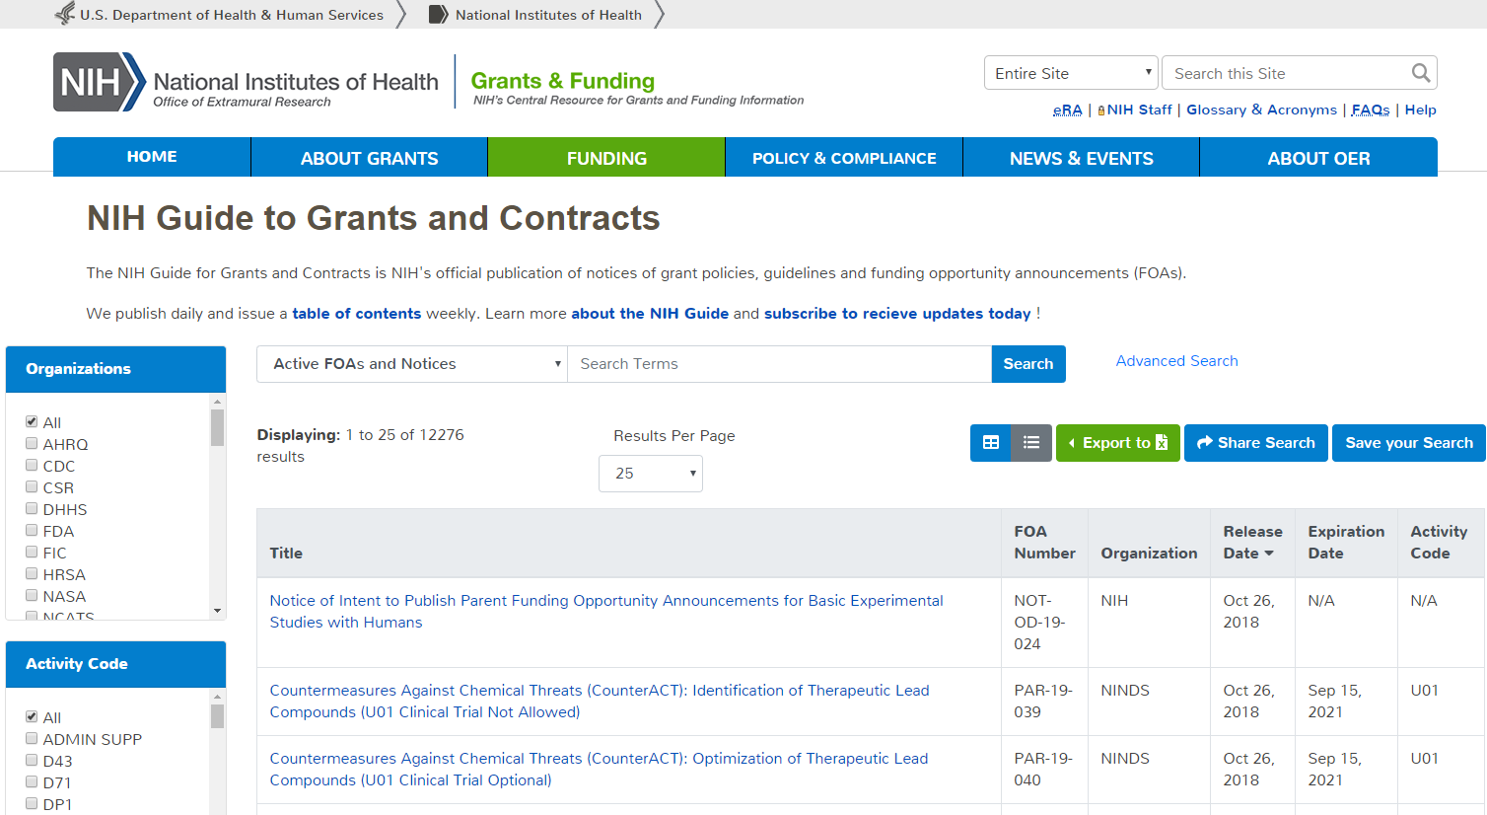
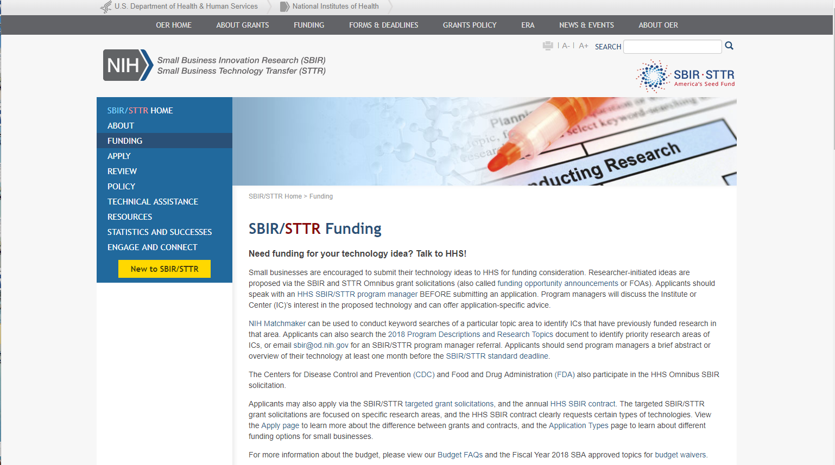
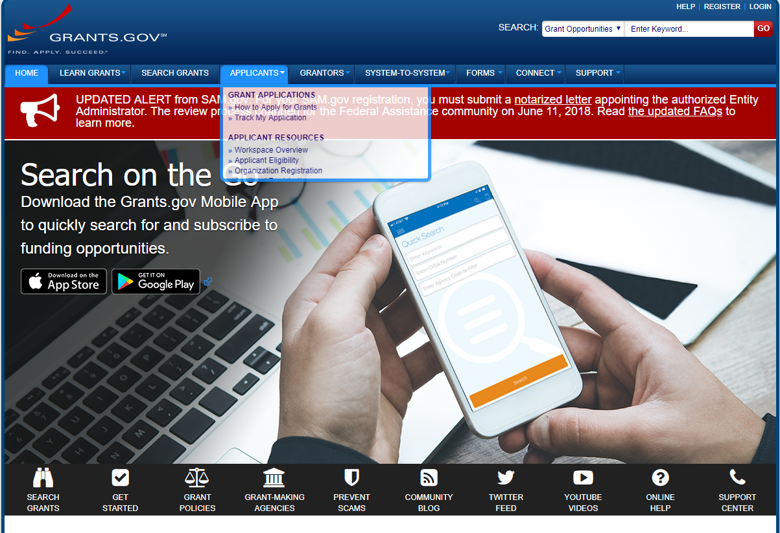
Grants.gov https://www.grants.gov
NIH Guide to Grants and Contracts https://grants.nih.gov/funding/searchguide/index.html
NIH Small Business website https://sbir.nih.gov/funding

Slide 11
Navigating Funding Opportunity Announcements (FOAs)

Slide 12
FOA Table of Contents
Part 1. Overview Information
Title, Participating Organization(s), Key Dates
Part 2. Full Text of the Announcement
Section I. Funding Opportunity Description Section II. Award Information Section III. Eligibility Information Section IV. Application and Submission Information Section V. Application Review Information Section VI. Award Administration Information Section VII. Agency Contacts Section VIII. Other Information

Slide 13
Common Key Items to Consider
Understanding options, expectations and requirements
“expected”; “should”; “encouraged” vs. “must”; “required”
Impact on submitting a complete, responsive, and compliant grant application
Requirements for successful submission
Submitted by due date: Key Dates
Responsiveness: Section I – Scope
Only applicable to RFAs
Compliance: Section II – Budget, Project Period - and NIH policy
Eligibility: Section III – Institution, PD/PI, Number of applications
Completeness: Section IV – Application Instructions

Slide 14
FOAs will state Clinical Trial options
FOA title & Section II will indicate Clinical Trial acceptance
Clinical Trial Not Allowed
Clinical Trial Optional
Clinical Trial Required

Slide 15
Part 1. Overview Information
Participating Organization(s) | National Institutes of Health (NIH)
Components of Participating Organizations | National Institute on Aging (NIA)
Funding Opportunity Title | Development of Personalized In Vitro Assays to Quantitatively Assess Age-related Changes in Cellular Resiliencies to Physiologic Stressors (R43/R44 Clinical Trial Not Allowed)
Activity Code | R43/R44 Small Business Innovation Research (SBIR) Grant - Phase I, Phase II, and Fast-Track
Announcement Type | New
Related Notices | None
Funding Opportunity Announcement (FOA) Number | RFA-AG-19-025
Companion Funding Opportunity | RFA-AG-19-026, STTR R41/R42- Phase I, Phase II, and Fast Track
Number of Applications | See Section III. 3. Additional Information on Eligibility.
Catalog of Federal Domestic Assistance (CFDA) Number(s) | 93.866
Funding Opportunity Purpose | This Funding Opportunity Announcement (FOA) encourages Small Business Innovation Research (SBIR) applications for the development and commercialization of standardized in vitro assays of resilience at the cellular level. [excerpted text from RFA-AG-19-025]

Slide 16
Part 1. Overview Information
Posted Date | October 25, 2018
Open Date (Earliest Submission Date) | February 8, 2019
Letter of Intent Due Date(s) | February 8, 2019
Application Due Date(s) | March 8, 2019, by 5:00 PM local time of applicant organization. Applicants are encouraged to apply early to allow adequate time to make any corrections to errors found in the application during the submission process by the due date.
AIDS Application Due Date(s) | Not Applicable
Scientific Merit Review | June/July 2019
Advisory Council Review | August 2019
Earliest Start Date | September 2019
Expiration Date | March 9, 2019
Due Dates for E.O. 12372 | Not Applicable

Slide 17
Part 2. Section I Funding Opportunity Description
Purpose: Goals of the funding opportunity
Background: Relevant background information and the importance of the funding opportunity
Research Objectives: Description of specific areas of research interest; examples of targeted research topics and/or and experimental approaches that are being sought to achieve the objectives.
Responsiveness statement: Description of scientific areas pursued and/or those not pursued through the FOA

Slide 18
Part 2. Section II - Award Information
Funding Instrument | Grant: A support mechanism providing money, property, or both to an eligible entity to carry out an approved project or activity.
Application Types Allowed | New (Phase I, Fast-Track) New (Phase II) The OER Glossary and the SF424 (R&R) SBIR/STTR Application Guide provide details on these application types.
Clinical Trial? | Not Allowed: Only accepting applications that do not propose clinical trials Need help determining whether you are doing a clinical trial?
Funds Available and Anticipated Number of Awards | The number of awards is contingent upon NIH appropriations and the submission of a sufficient number of meritorious applications. NIA intends to commit $4 million in FY 2019 to fund up to 12 awards.
Award Budget | Budgets up to $225,000 total costs per year for Phase I and up to $750,000 total costs per year for Phase II may be requested with appropriate justification.
Award Project Period | According to statutory guidelines, award periods normally may not exceed 6 months for Phase I and 2 years for Phase II. Applicants are encouraged to propose a project duration period that is reasonable and appropriate for completion of the research project.

Slide 19
Part 2. Section III - Eligibility Information
Eligible institutions
Application is submitted by institution
Eligible individuals
Only applicable for PD/PI
Number of applications

Slide 20
Part 2. Section IV Application & Submission Information
Letters of Intent
Requested in some FOAs to help plan the review
Although not required and not provided to reviewers, these are very helpful

Slide 21
Part 2. Section IV Application & Submission Information
Instructions for Application Submission
Lists of all the forms available in the application package
Instructs applicant to follow instructions in the SF 424 (R&R) Application Guide in addition to FOA-specific instructions

Slide 22
Part 2. Section V.1 - Application Review Information/Criteria
Review criteria
Standard review criteria used to evaluate scientific and technical merit
Only PARs and RFAs may have non-standard review criteria
Each additional review question is explained to applicants earlier in the FOA

Slide 23
Part 2. Section V.2 – Review and Selection Process
The following will be considered in making funding decisions:
Scientific and technical merit of the proposed project as determined by scientific peer review.
Availability of funds.
Relevance of the proposed project to program priorities.

Slide 24
Part 2. Section VI Award Administration Information
Award Notices
FOA-specific provisions to be included in Notice of Award
Cooperative Agreement Terms and Conditions of Award (only for U activity codes)
Reporting requirements

Slide 25
Part 2. Section VII - Agency Contacts
Application Submission Contacts
Grants.gov Customer Support: Grants.gov registration and submission, downloading forms
GrantsInfo: Application instructions and process, finding NIH grant resources
eRA Service Desk: eRA Commons registration, submitting and tracking an application, documenting system problems that threaten submission by the due date
SBA Company Registry

Slide 26
Part 2. Section VII - Agency Contacts
FOA-specific contacts
Scientific/Research
Peer Review
Financial/Grants Management

Slide 27
Pop Quiz – Ready?

Slide 28
Which of these is not a type of FOA?
Request for Applications (RFA)
Program Announcement (PA)
Statement of Work
Parent Announcement

Slide 29
The _____ website provides information on grant funding opportunities available at NIH?
Grants.gov
NIH Guide to Grants and Contracts
Table of Contents (TOC)
All of the above
Only A and C

Slide 30
In which section of the FOA are the budget and other form page instructions found?
Part 1 – Overview
Part 2. Section II (Award Info.)
Part 2. Section IV (Application and Submission Info.)
Part 2. Section V (Review Info.)

Slide 31
Can a RFA specify scientific areas that would cause an application to be withdrawn and not proceed to peer review?
Yes
No
Let me check with my neighbor ☺

Slide 32
Questions

