Slide 1
NIH Biosketch and SciENcv
NIH Regional Seminar 2019
UnJa Hayes, Ph.D.
Scientific Review Officer
Center for Scientific Review, NIH
and
Betsy Read-Connole, Ph.D.
Program Officer
National Cancer Institute, NIH

Slide 2
Session Plan
Review the NIH biosketch
Discuss SciENcv, an online tool to simplify biosketch creation for multiple agencies
Notes:
SciENcv is an NIH tool to help you develop your biosketch and automatically format it according to NIH requirements.

Slide 3
The NIH Biosketch
UnJa Hayes, Ph.D.
Scientific Review Officer
Center for Scientific Review
NIH
May 16, 2019

Slide 4
NIH Institutes and Centers
Office of the Director
National Institute
on Aging
National Institute
on Alcohol Abuse
and Alcoholism
National Institute
of Allergy and
Infectious Diseases
National Institute
of Arthritis and
Musculoskeletal
and Skin Diseases
National Cancer
Institute
Eunice Kennedy
Shriver National Institute
of Child Health and
Human Development
National Institute on
Deafness and Other
Communication
Disorders
National Institute
of Dental and
Craniofacial
Research
National Institute
of Diabetes and
Digestive and
Kidney Diseases
National Institute
on Drug Abuse
National Institute
of Environmental
Health Sciences
National Eye
Institute
National Institute
of General
Medical Sciences
National Heart,
Lung, and Blood
Institute
National Human
Genome Research
Institute
National Institute
of Mental Health
National Institute
of Neurological
Disorders and
Stroke
National Institute
of Nursing Research
National Institute of
Biomedical Imaging
and Bioengineering
National Center for
Complementary and
Integrative Health
John E. Fogarty
International
Center
National Center
for Advancing
Translational Sciences
National Library
of Medicine
National Institute on
Minority Health and
Health Disparities
Clinical Center
Center for
Information
Technology
Center for
Scientific Review

Slide 5
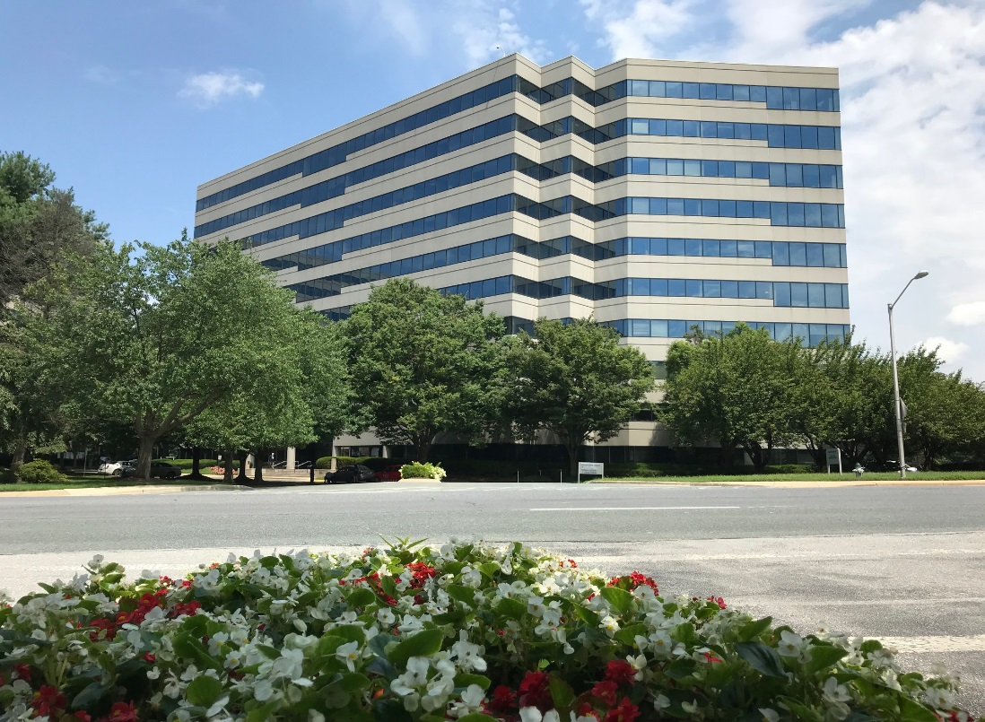
The Gateway for NIH Grant Applications
The Center for Scientific Review
Receives all NIH applications
Refers them to NIH Institutes/Centers and to scientific review groups
Reviews the majority of NIH grant applications for scientific merit
Notes:
CSR numbers for 2017 (Update for 2018)
95,000 applications received
61,000 applications reviewed
18,000 reviewers
247 Scientific Review Officers
1,600 review meetings

Slide 6
Why?
Allows applicants to:
describe the magnitude and significance of their scientific contributions (including publications)
provide detailed information about their research experience in the context of the proposed project
Forms, instructions, and samples available at:
https://grants.nih.gov/grants/forms/biosketch.htm
Notes:
Since the biosketch is required for all types of grant programs,
today we want to make sure you understand the sections of the biosketch and how important it is to customize this for your applications.
In particular, you will want to emphasize the significance of the investigator’s scientific contributions and provide details about their research experience and career in general.
This is the only place in the application to make this case and for the investigator to talk about themselves.

Slide 7
Who?
All senior/key personnel and other significant contributors (OSCs) must include biographical sketches (biosketches).
Notes:
Grant applications must include biosketches for all key personnel and other significant contributors
Remember that the investigator and many of your key personnel also need to register in commons, postdocs and students, and so make sure that is handled well in advance.
Other significant contributors are those that are zero-person months or ‘as needed’, and they do not expect to provide measurable effort towards the project

Slide 8
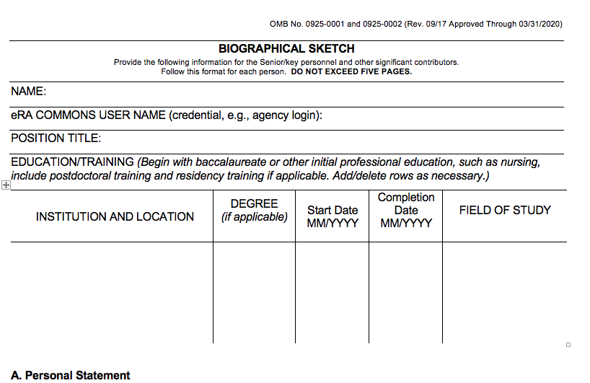
NIH Biosketch Form
Forms, instructions, and samples available at:
https://grants.nih.gov/grants/forms/biosketch.htm
Notes:
You can find the biosketch template forms on the NIH website at the link below, and I can provide the updated slides for you after the talk.
This is the current form, but If you use SciENcv to prepare your bio sketch, you will always be using the latest version of the template.
The first thing you need to know is that there is a five (5) page limit. Failure to follow the policy means NIH may withdraw your application from consideration (NOT-OD-15-095).
How you use the pages for the multiple sections is up to you, but you should review and compare with your colleagues
At the top of the form are where you put your name, title and commons information, along with your educational and any medical residency positions, all of which are pretty self-explanatory.
Remember that the investigator and many of your key personnel also need to register in commons, postdocs and students, and so make sure that is handled well in advance.

Slide 9
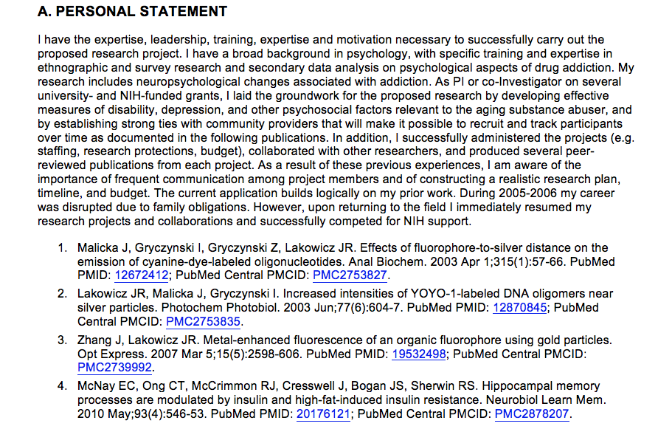
NIH Biosketch Form, Section A
Your qualifications for your role on the project
Notes:
Next up is the Personal Statement section, where you make your case why you are well-suited to your role on the project.
You might include key aspects of training or past experience, technical expertise, significant collaborations, and past performance
This is also an opportunity to explain anything else you’d like the reviewers to know about your career and research directions.
For instance, this is where you can describe how you are proposing work in a new direction, or significant training or mentorships relationships, or any personal or family situations such as parental leave, child care, elder care, or medical conditions
Finally, you can provide information on up to 4 publications or research products, and this is not limited to publications—it could be key software, videos, research methods or models, or a variety of other interim products. I have a slide later that specifically mentions the policies regarding these interim products.
Common mistakes:
Not customizing personal statement to the project.

Slide 10
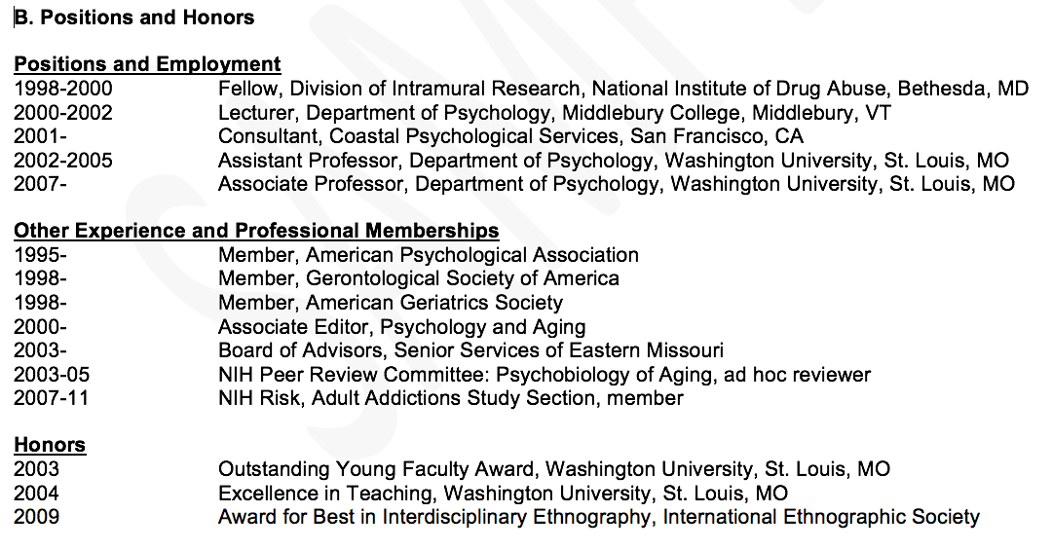
NIH Biosketch Form, Section B
Your relevant positions and honors
Notes:
Section B for positions and honors is fairly self-explanatory, where you can list your current and past positions that are relevant to the proposal.
If you are moving to an new organization, you can note the expected start date.
You may also wish to include any board certifications or clinical licensures that are relevant.

Slide 11
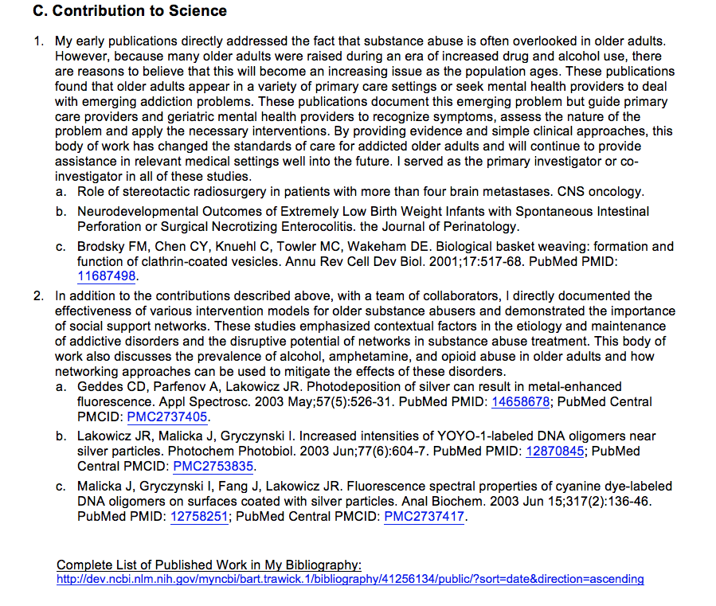
NIH Biosketch Form, Section C
Your general scientific contributions and achievements
Notes:
In the Contributions section, applicants may list up to 5 significant contributions, each around a half page in length, and each with up to 4 publications. You note the historical background, the central finding, how that affected your field or the application to health or technology, and most importantly, your role in the work.
Make this personal!
For junior investigators, it’s expected that they will have fewer contributions, but they can cite conference proceedings such as meeting abstracts, posters or other presentations, (in-progress products can be mentioned, but not cited), and the citations do not have be authored by the investigator , but do have to be relevant to your contributions.
You can also submit a hyperlink to an on-line bibliography but it must be hosted on federal (.gov) website.

Slide 12
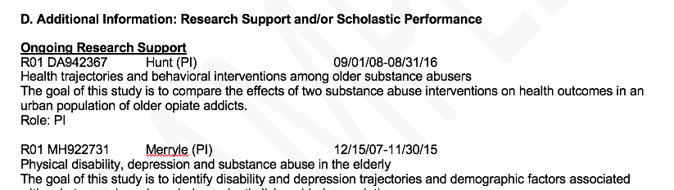
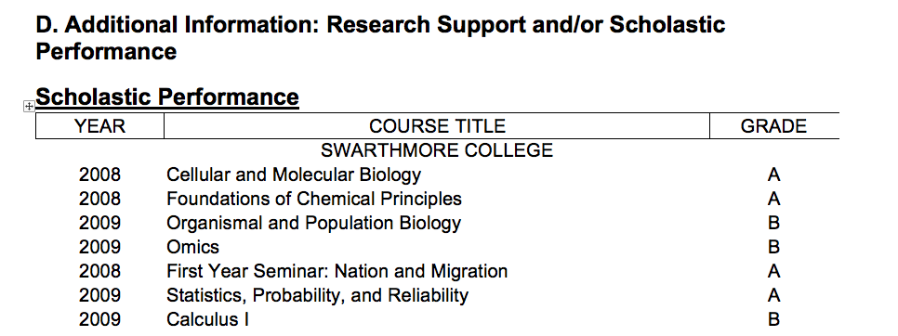
NIH Biosketch Form, Section D
Your research support and/or scholastic performance
Notes:
Additional Information: Research Support and/or Scholastic Performance
This section should be straightforward to complete. You can list any of your ongoing or completed research support, focusing on the goal of the research and your role. The description is likely something you can pull right from the abstract.
Fellowship applicants list their courses and grades, and are not expected to list research support, but they can if they have some, which may be important for post-doctoral applicants.

Slide 13
Interim Research Products
Complete, public research products that are not final
https://nexus.od.nih.gov/all/2017/03/28/following-up-on-interim-research-products/
Optional examples
  Preprints are complete and public drafts of a scientific documents. Arguably speeds dissemination, establishes priority, generates feedback, and may reduce publication bias.
  Pre-registering protocols is publicly declaring key elements of a research project in advance.
  Example: Bar DZ, Atkatsh K, Tavarez U, Erdos MR, Gruenbaum Y, Collins FS. Biotinylation by antibody recognition- A novel method for proximity labeling. BioRxiv 069187 [Preprint]. 2016 [cited 2017 Jan 12]. Available from: https://doi.org/10.1101/069187.
  https://grants.nih.gov/grants/interim_product_faqs.htm
Guide notice: Reporting Preprints and Other Interim Research Products
https://grants.nih.gov/grants/guide/notice-files/NOT-OD-17-050.html
Notes:
Interim research products are an important way to demonstrate the investigator’s broader reach, and since last year you can now cite these in all your communications with NIH.
These are complete, public research products that are not final, and thyou can cite a greater variety of research products, not just peer-reviewed publications.
There are specific benefits that we hope may come from these interim research products, where scientific dissemination can be sped up or reduce publication bias against negative result, or preregistered studies to increase public confidence in clinical studies.
If you have any further questions on interim research products and how yarn where you can cite them, I’d refer you to this blog post by Mike Lauer or the full guide notices. All of these changes have been inserted into the instructions for application

Slide 14
Biosketch Compliance
  All biosketches must be formatted per the instructions in the application guide:
  All sections completed
  No more than 5 contributions with no more than 4 citations per contribution
  A “.gov” URL for the optional link to a full list of your published work
  No overstuffing
  Approved formatting
  Five (5) pages or less
  Failure to follow the policy means NIH may withdraw your application from consideration (NOT-OD-15-095).
Notes:
Refraining from including information, such as preliminary data, that belongs elsewhere in the application
After submission:
Using PDF format for your biosketch attachment
Limiting the length of your biosketch to 5 pages or less

Slide 15
Biosketch Summary
General advice
  Make it personal
    Only opportunity to tell the reviewers about you, your career, and expertise
    Seek advice and examples from peers and senior colleagues about what a biosketch looks like
  Help the reviewers!
    Demonstrate that you are the most qualified investigator to do the work
    Reviewers instructed that publication track record for early career investigators may not match more established investigators
    Favor clarity over detail and jargon
  Opportunity to cite interim research products
  Provide a URL to publications via a federal (.gov) website
Notes:
In closing, this is your one opportunity for the investigator to show they are the best, most appropriate person to lead the study, and the only place to share important information about your career, and any personal or family responsibilities that have caused a gap
In crafting this, make sure you look at the online examples and get examples from your colleagues.
Help the reviewers make a case for you in the study section. Reviewers are instructed to take your career stage into account, but make sure to make that case yourself.
Be concise and clear, and don’t overstuff the section. Try to use shorter sentences, bullets and shorter paragraphs
Look for opportunities to cite interim research products if you have them, and if you want to share your full bibliography you can do so on a .gov website.

Slide 16

Biosketch Summary
Serve as a reviewer
  CSR’s Early Career Reviewer (ECR) Program
    https://public.csr.nih.gov/ForReviewers/BecomeAReviewer/ECR
  Contact your friendly SRO
    https://public.csr.nih.gov/ForApplicants/SubmissionAndAssignment
Notes:
Notify your SRO of your interest to review, send your CV and specify areas of expertise
Check Out Our Early Career Reviewer Program: www.csr.nih.gov/ecr
Contact a CSR Scientific Review Officer: Send them your CV
Let Us Try to Find a Good Review Group for You: Send your CV to csrvolunteer@mail.nih.gov

Slide 17
SciENcv Overview
Betsy Read-Connole Ph.D.
Division of Cancer Biology, National Cancer Institute, NIH

Slide 18
SciENcv = Science Experts Network Curriculum Vitae
  Vision- Let investigators harvest their data from multiple systems to support funding applications, reporting and collaboration with less burden and complexity
Goals
  Reduce burden of applying for federal funds and maintaining federal profiles
  Track impact of federal investments in science and scientist careers through scientist-curated data
  Support collaboration and networking services to find reviewers, collaborators, mentors, etc.
Products to date
  NIH biosketches, NSF biosketch, Ed IES biosketch
  Embedded XML
  Integration with ORCID, Fastlane, PubMed and eRA
  Bulk upload of citations from reference manager software
  Internal refinements: user testing, adopting agile software principles

Slide 19
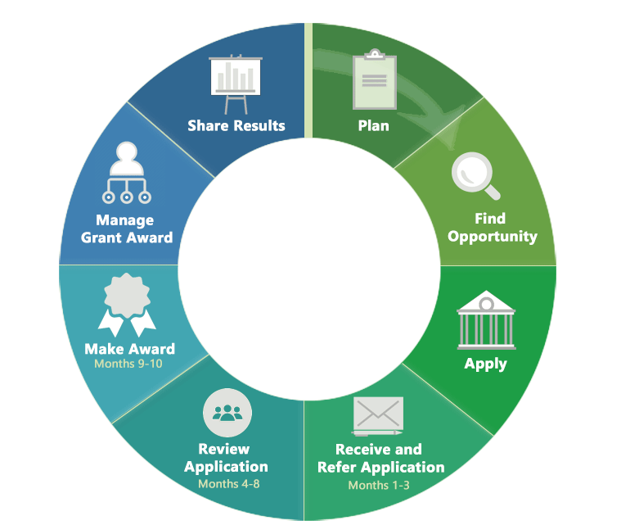
Research Funding Cycle
My Bibliography
SciENcv
Source: https://grants.nih.gov/grants/grants_process.htm

Slide 20
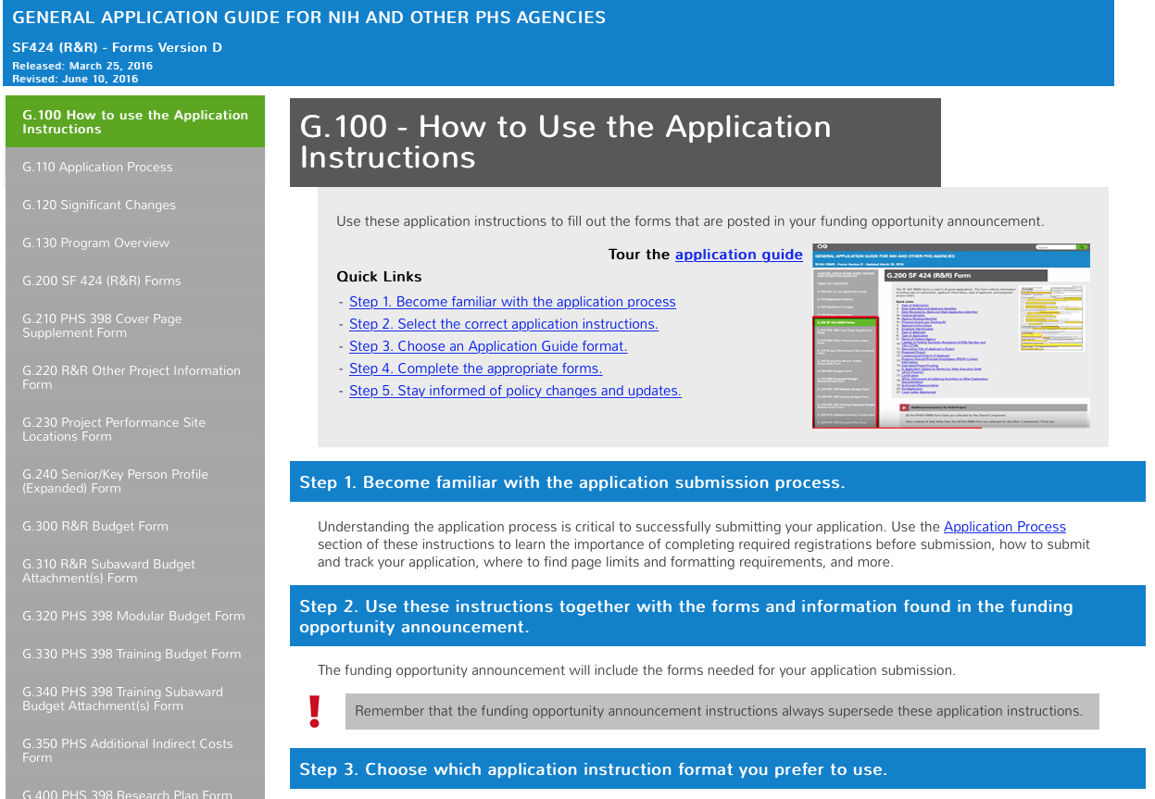
SF424 Application guide, 245 pages

Slide 21



Grants.gov
Cover letter
Budget
Research Plan
Biosketches
Bibliography
Facilities
Animal Welfare
Load to eRA
Completeness?
Determine area
Assign to IC
Assign to Review
SRO
Scoring
SciENcv

Slide 22




SciENcv = Science Experts Network Curriculum Vitae
  Leveraging existing data to support applications, reporting and collaboration
NIH grant/paper
reporting systems
SciENcv
My NCBI
Report Formats
SciENcv
NIH biosketch
NSF
Biosketch
My
Bibliography
NIH RPPR
eRA
Other Established
Inputs
User supplied RIS
CV format
PubMed
NIHMS
Federal API
RePORT?
Star Metrics?
COI/Reviewer tool?
PMC
Published
Articles
Author
Manuscripts

Slide 23
Getting Started with SciENcv
Notes:
N: Bart, how do we access SciENcv?

Slide 24
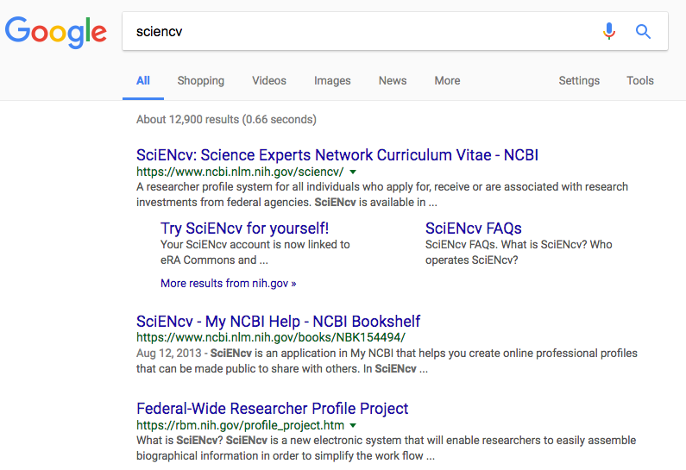
Where to start?
SciENcv homepage: http://www.ncbi.nlm.nih.gov/sciencv

Slide 25
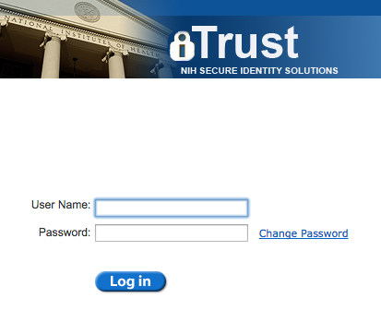
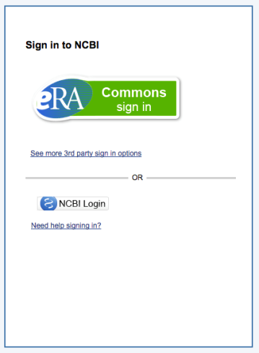
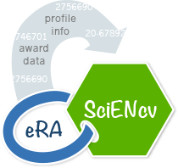
Linking an eRA Commons account

Slide 26
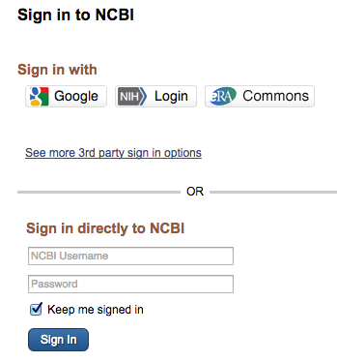
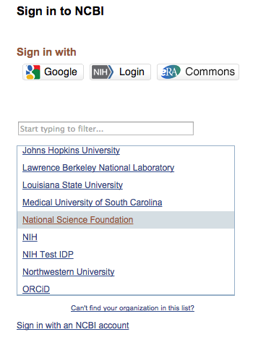
Other sign in options
Notes:
N: Bart, can NIH employees use SciENcv too?

Slide 27
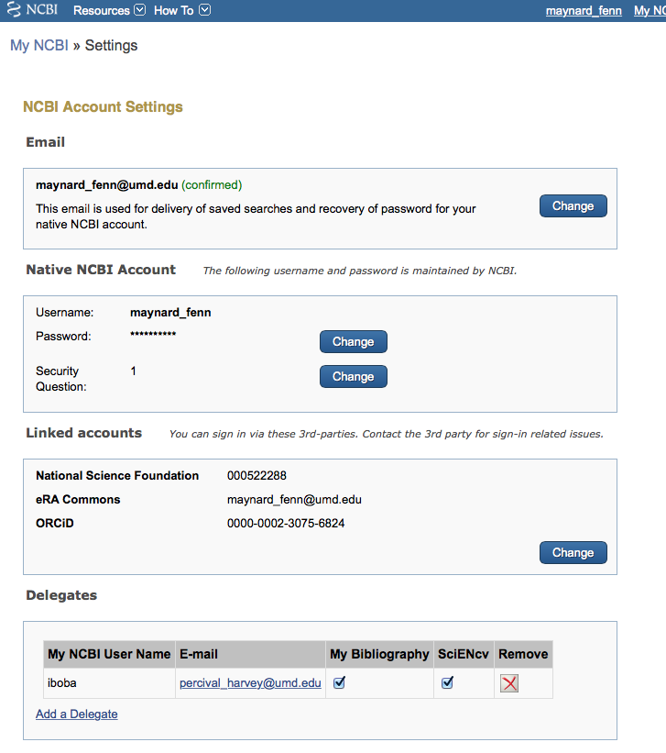
Linked accounts

Slide 28
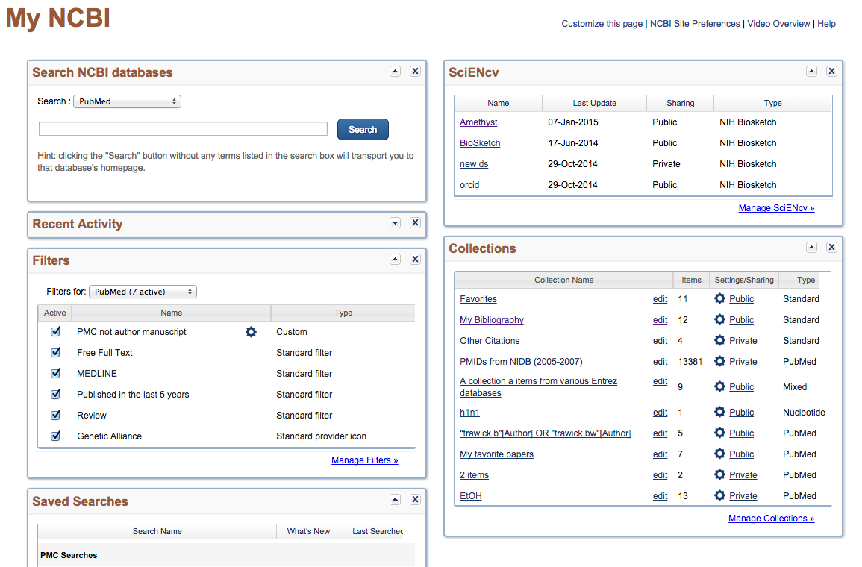
My NCBI main page
Notes:
N: Bart, what are all these windows for?

Slide 29
SciENcv main page
Notes:
N: Bart, What is a profile on sciENcv?

Slide 30



Creating a new SciENcv profile
From Scratch
From an external source (Including ORCiD)
Duplicate an existing profile
Notes:
N: Bart, what is ORCID?

Slide 31
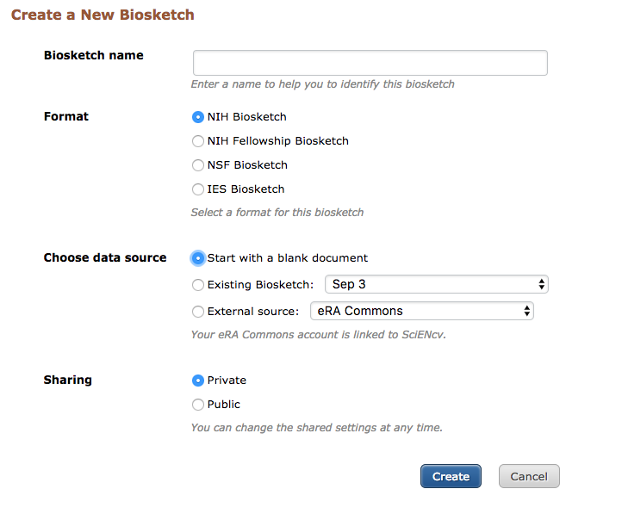
Create a new SciENcv profile page
Notes:
N: Bart, who can see a profile? Why would someone want to share it?

Slide 32
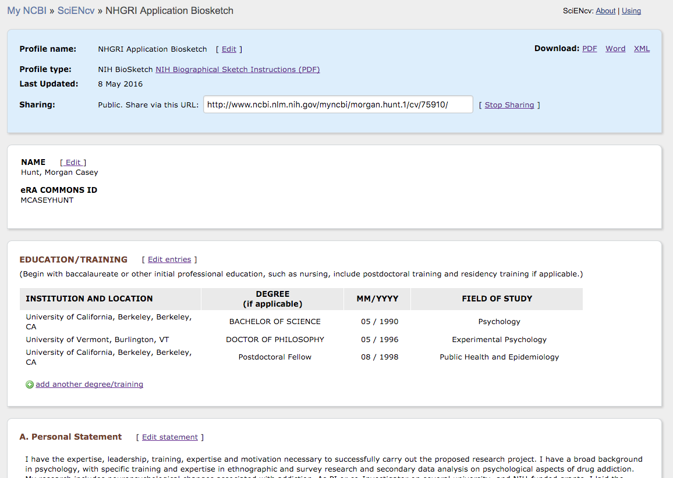
NIH Biosketch page
Metadata
& options
Biosketch
form

Slide 33
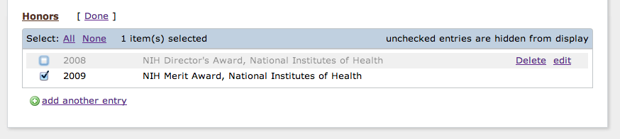
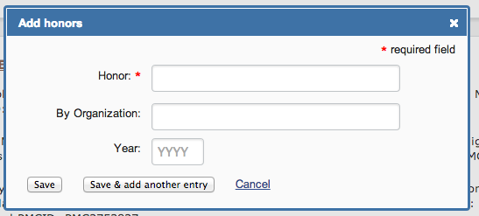
Controls for editing data
Show/hide item
Delete/edit existing items
Create new entry
New entry
dialog box

Slide 34
  Populating sections with linked data – pick lists
Pick list can dynamically update via feed.

Slide 35
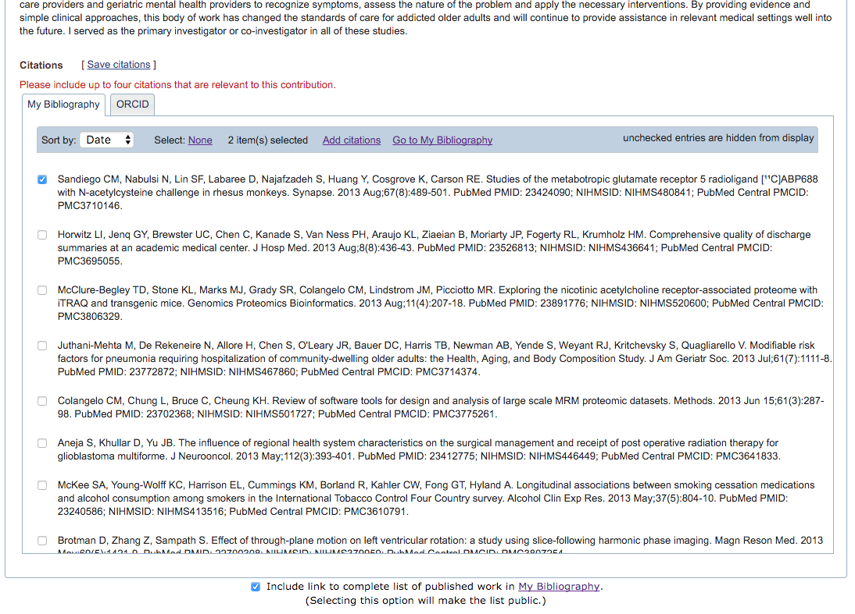
Selecting citations
Show/hide pick list
Data feeds
Notes:
N: Bart, what if my paper is not listed here? Should I add them to My Bibliography or ORCID? How do I decide?

Slide 36
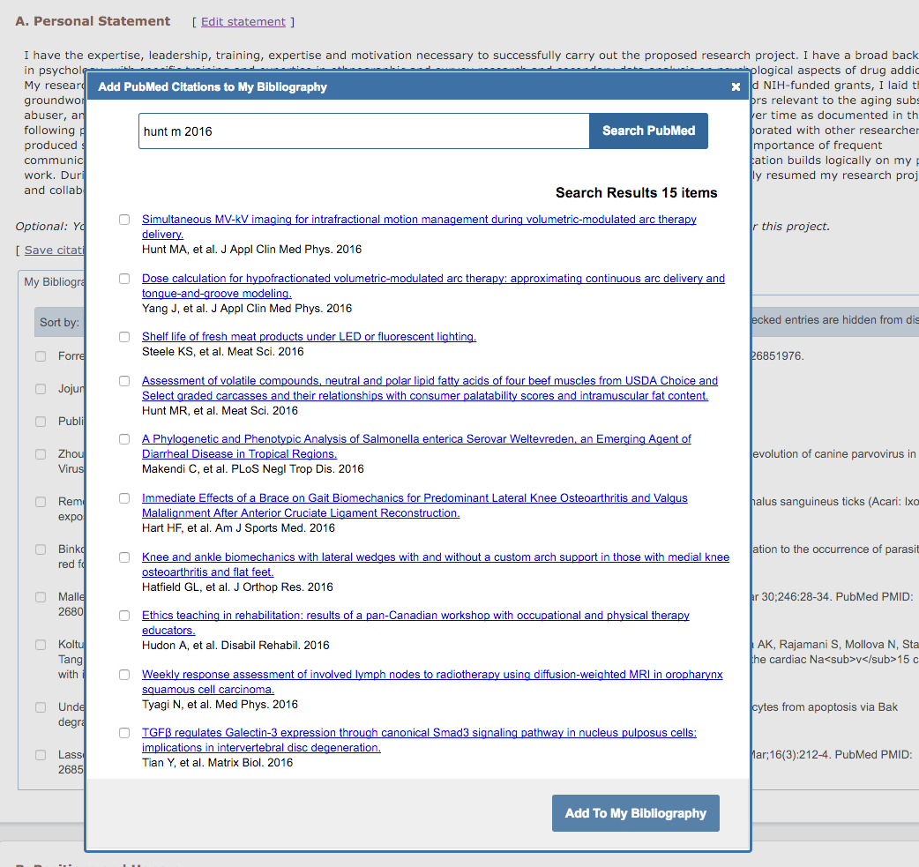
Search PubMed directly from SciENcv

Slide 37
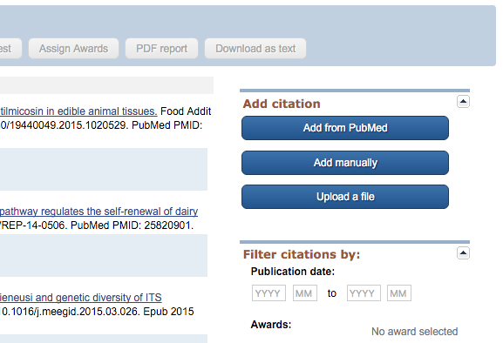
Options for adding citations to My Bibliography

Slide 38
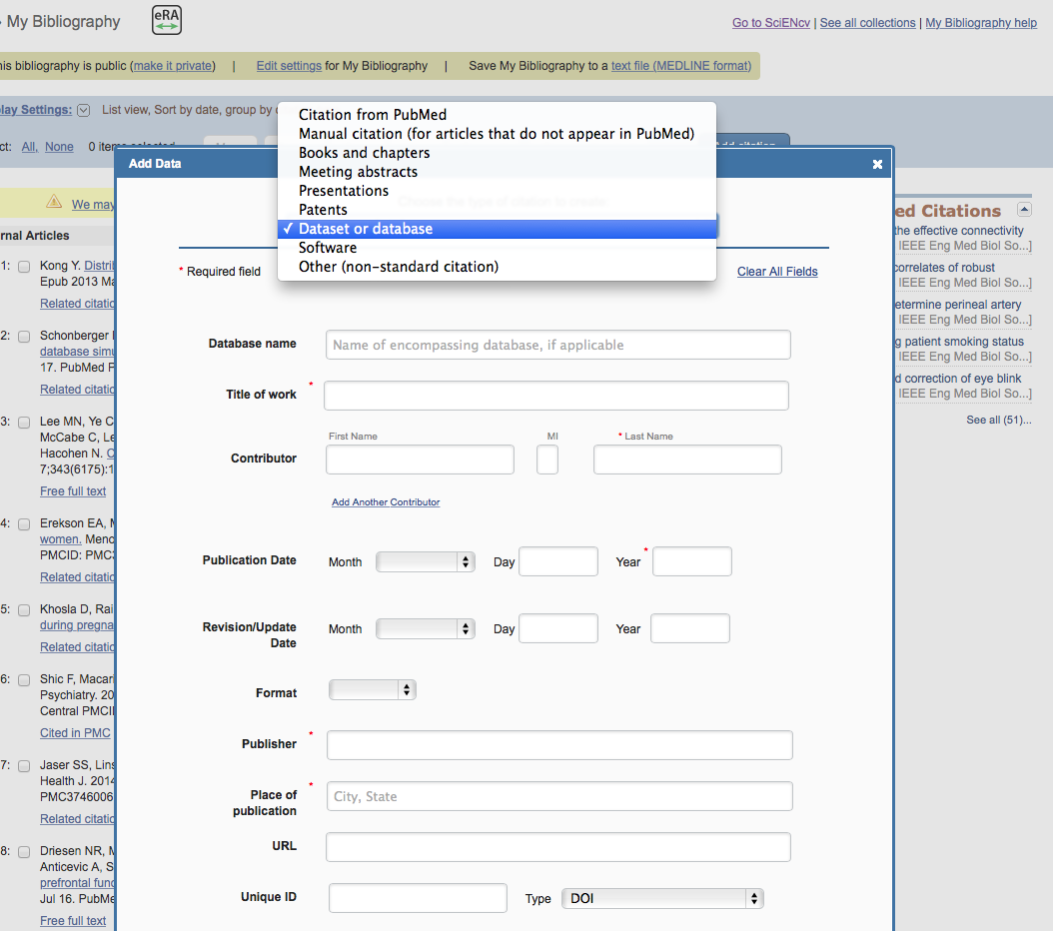
Additional citations types added to My Bibliography

Slide 39
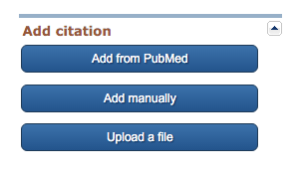
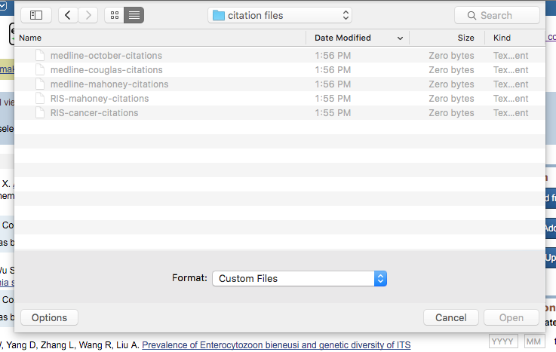

Bulk upload citations in MEDLINE or RIS formats
1. Click “Upload a file” button
2. Choose MEDLINE or RIS file
3. Success message

Slide 40
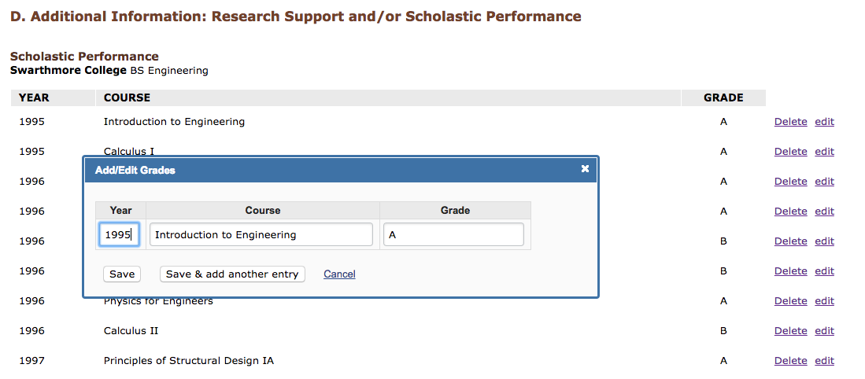
Fellowship biosketch
Add/Edit
grades
Notes:
N: Bart, what is the user tab? Is that manual entry?

Slide 41
Fellowship biosketch
Final Display
Notes:
N: Bart, what is the user tab? Is that manual entry?

Slide 42
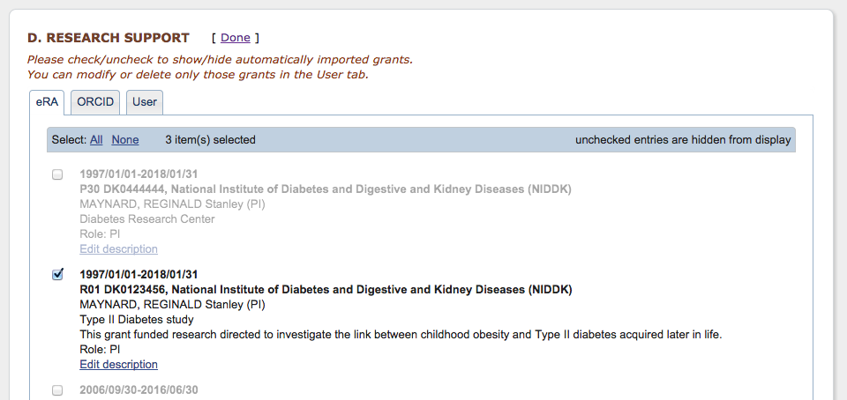
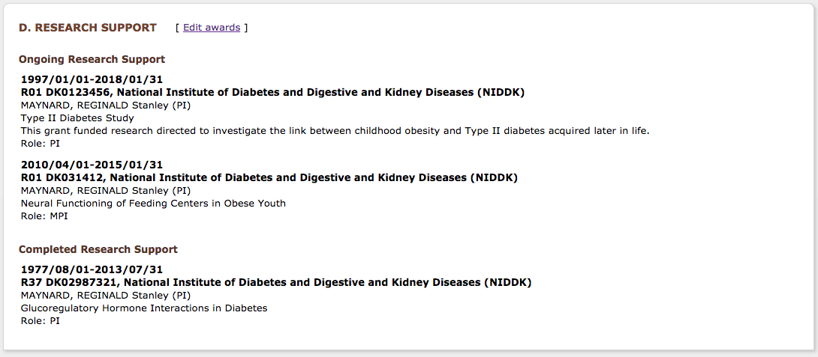
Selecting awards
Award data feeds
Show/hide pick list
Final Display
Notes:
N: Bart, what is the user tab? Is that manual entry?

Slide 43
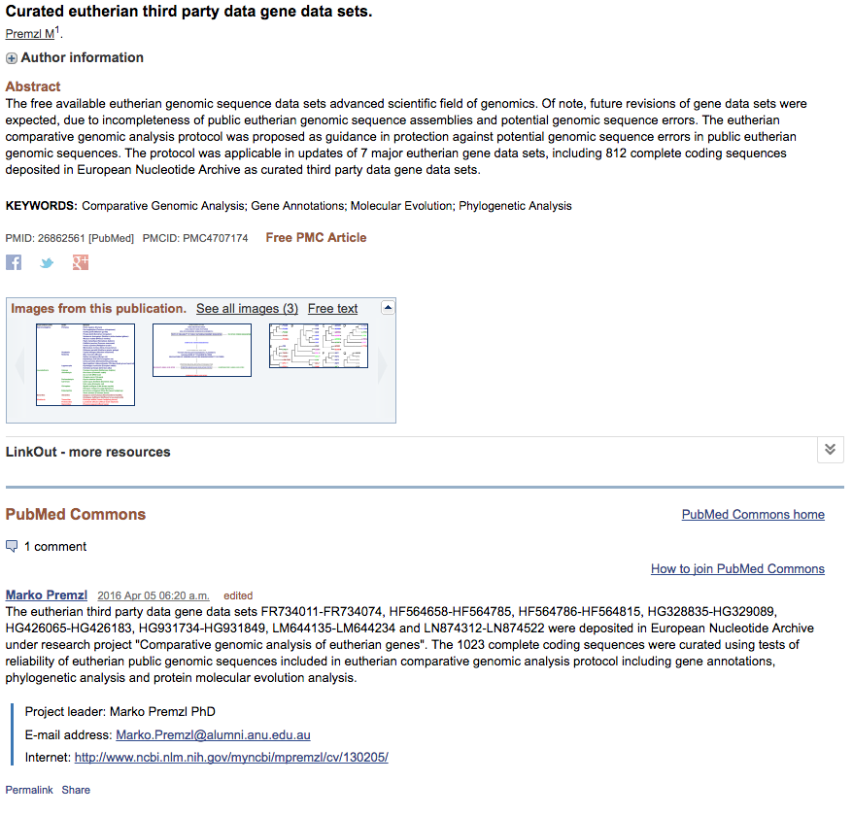
Sharing SciENcv Profiles

Slide 44
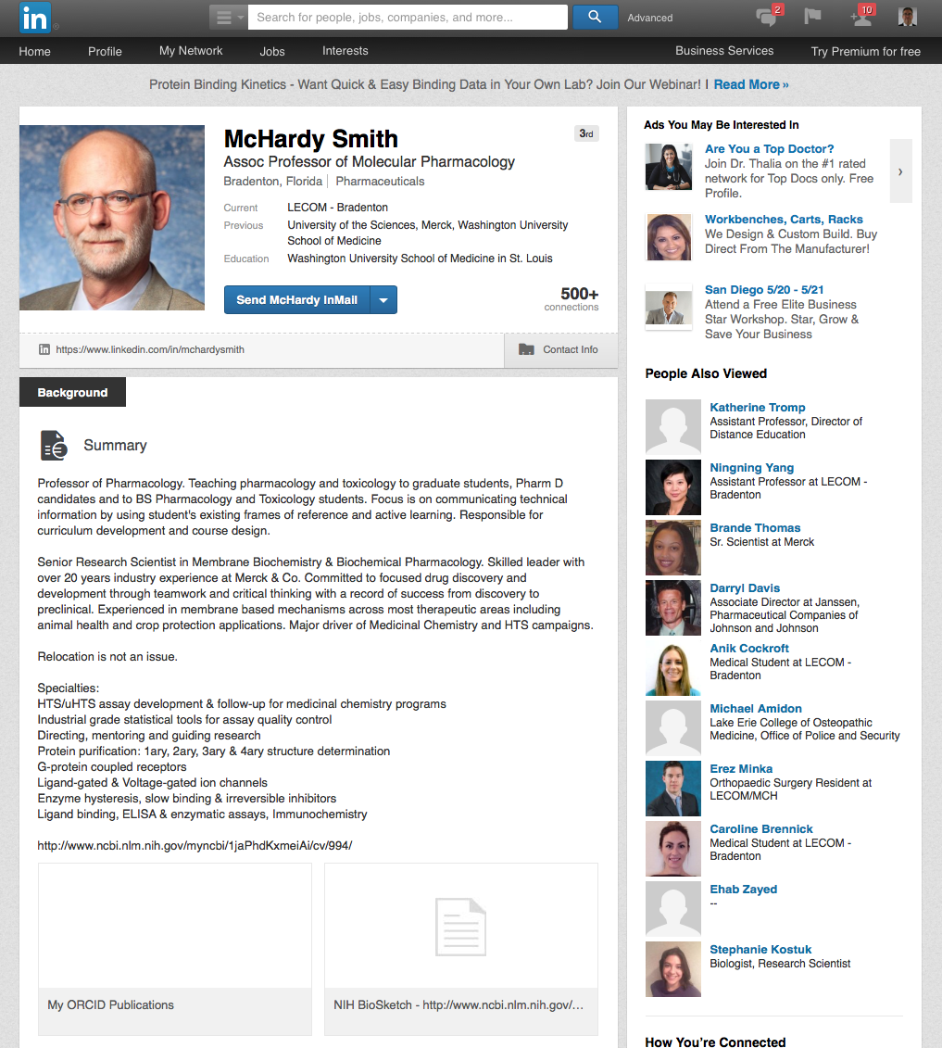
Sharing SciENcv Profiles
Notes:
SciENcv is an application in My NCBI that helps you create online professional profiles that can be made public to share with others. In SciENcv you can document your education, employment, research activities, publications, honors, research grants, and other professional contributions. My NCBI users can create multiple SciENcv profiles in official biographical sketch formats, for the National Institutes of Health (NIH), the National Science Foundation(NSF), and the Institute of Education Sciences (IES), which can be used for grant submissions. In addition, SciENcv profiles include, when registered with ORCID, your ORCID iD.
NIH eRA Commons, NSF FastLane, and ORCID account holders who have linked their accounts to NCBI can populate their SciENcv profiles with the information stored in their eRA, FastLane, or ORCID accounts. The information transferred to SciENcv can be changed, hidden, augmented or deleted. SciENcv users control the content displayed in their SciENcv profiles.
For details on the mission and guiding principles of the Science Experts Network Curriculum Vitae project, go to SciENcv project. Institutions interested in obtaining a copy of the current data schema can download it from about SciENcv.

Slide 45
Helpful Links
My NCBI documentation:
http://www.ncbi.nlm.nih.gov/books/NBK3843/
Movie tutorial on managing compliance:
http://youtu.be/JYODIOD_YYE
NIH Public Access Policy homepage:
http://publicaccess.nih.gov/
SciENcv is available at:
  http://www.ncbi.nlm.nih.gov/account/
SciENcv documentation: http://www.ncbi.nlm.nih.gov/sciencv
SciENcv video overview: http://youtu.be/PRWy-3GXhtU
Provide feedback to info@ncbi.nlm.nih.gov

Slide 46
Interim Research Products
Where
  RPPRs: Preprints in Section C1; other products in section C5
  Applications: Progress Report Publication List, Biosketch
Citation format standards: DOI, list object type (e.g. Preprint, protocol)
Example: Bar DZ, Atkatsh K, Tavarez U, Erdos MR, Gruenbaum Y, Collins FS. Biotinylation by antibody recognition- A novel method for proximity labeling. BioRxiv 069187 [Preprint]. 2016 [cited 2017 Jan 12]. Available from: https://doi.org/10.1101/069187.
To cite preprints arising from NIH awards DOI Recommend CC-BY license Statement: not peer-reviewed Acknowledge funding Declare competing interests | Repository best practices FAIR principles (Findable, Accessible, Interoperable, Reusable) Open metadata Machine accessible and readable Transparent policies Versioning links to published version Tracks key changes Permanent/archival plan
Guide notice: Reporting Preprints and Other Interim Research Products
https://grants.nih.gov/grants/guide/notice-files/NOT-OD-17-050.html

