Slide 1
The NIH Peer Review Process
NIH Regional Seminars 2019
Sally A. Amero, Ph.D. Amy Wernimont Ph.D.
NIH Review Policy Officer Scientific Review Officer
Extramural Research Integrity Liaison Officer IMST IRG
Office of Extramural Research Center for Scientific Review
National Institutes of Health National Institutes of Health
Notes:
Sally

Slide 2
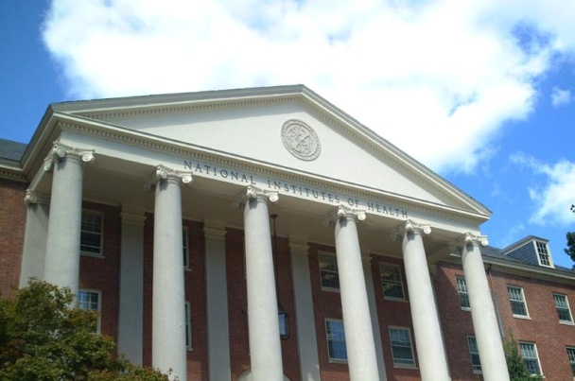
NIH Peer Review
Cornerstone of NIH extramural research
Standard of excellence worldwide
Two-stage review process
Receipt and Referral
Initial Peer Review
National Advisory Council
Review
Submit your
application
Funding
decision
2

Slide 3
Scope of NIH Initial Peer Review
Use ˃ 26,000 reviewers/yr
Fill ˃ 52,000 “slots”/yr
Individual reviewers
Applications reviewed
NIH Data Book (https://report.nih.gov/nihdatabook/)
3

Slide 4
Division of Receipt and Referral (DRR)
Key decisions
  Policy compliance (format, timeliness, etc.)
  Assignment to Institute(s) for funding consideration
  Assignment to study section for initial peer review
Funding Institute(s)
Scientific Review Group
Initial Review Groups (CSR or ICs)
Scientific Focus & Mission Relevance
Program Officials (POs)
Scientific Review Officers (SROs)
DRR
Council
IC
Director
Application

Slide 5
National Institutes of Health
Office of the Director
National Institute
on Aging
National Institute
on Alcohol Abuse
and Alcoholism
National Institute
of Allergy and
Infectious Diseases
National Institute
of Arthritis and
Musculoskeletal
and Skin Diseases
National Cancer
Institute
Eunice Kennedy
Shriver National Institute
of Child Health and
Human Development
National Institute on
Deafness and Other
Communication
Disorders
National Institute
of Dental and
Craniofacial
Research
National Institute
of Diabetes and
Digestive and
Kidney Diseases
National Institute
on Drug Abuse
National Institute
of Environmental
Health Sciences
National Eye
Institute
National Institute
of General
Medical Sciences
National Heart,
Lung, and Blood
Institute
National Human
Genome Research
Institute
National Institute
of Mental Health
National Institute
of Neurological
Disorders and
Stroke
National Institute
of Nursing Research
National Institute of
Biomedical Imaging
and Bioengineering
National Center
for Complementary
and Integrative Health
John E. Fogarty
International
Center
National Center for
Advancing Translational
Sciences
National Library
of Medicine
National Institute on
Minority Health and
Health Disparities
Clinical Center
Center for
Information
Technology
Center for
Scientific Review

Slide 6

Submitting a Cover Letter
The cover letter conveys important information:
  Application title
  FOA # and title
  Any special situations (such as a late application)
  Statement if proposed studies will generate large-scale genomic data or if a video will be submitted

Slide 7
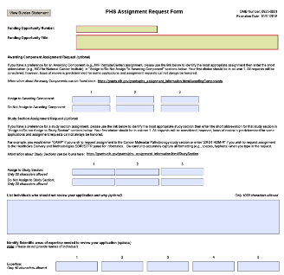
PHS Assignment Request Form
The PHS Assignment Request form conveys:
  Awarding component assignment requests
  Study section assignment requests
  Individuals who should not review your application and why
  Expertise needed to review the application
Optional form in all NIH application form packages.

Slide 8
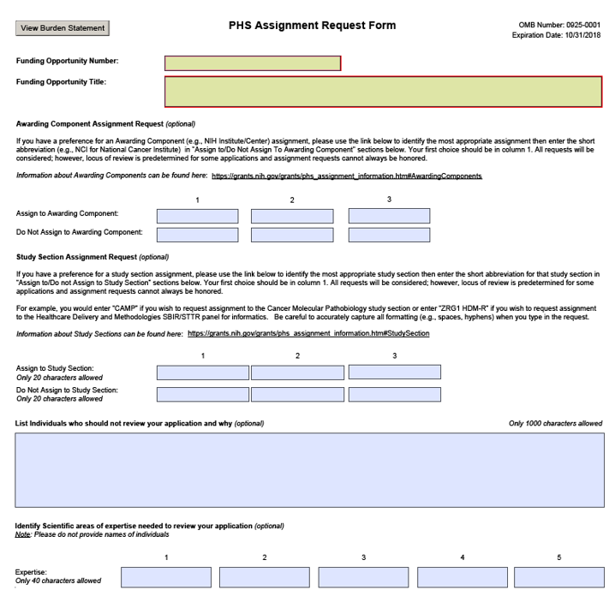
New PHS Assignment Request form

Slide 9
Requesting a Study Section
Information about study sections:
  Center for Scientific Review study sections http://public.csr.nih.gov/StudySections/Pages/default.aspx
  Assisted Referral Tool (ART)
  https://art.csr.nih.gov/ART/selection.jsp
  Rosters are available on NIH websites https://public.era.nih.gov/pubroster/
  http://www.csr.nih.gov/Committees/rosterindex.asp
  eRA Like (A Thesaurus-based Search Tool)
      http://era.nih.gov/services_for_applicants/like_this/likethis.cfm
Not all study section/IC requests can be honored.

Slide 10

Post-Submission Materials
Submitted after the application, and must:
    Result from an unforeseen administrative event
    Conform to format policy and page limits
    Be submitted to the SRO 30 days before the review
    Demonstrate concurrence of Authorized Organization Representative
  Some Funding Opportunity Announcements may
    Specify other allowable materials
    Change the time window

Slide 11
Post-Submission Materials
  Among materials allowed (See NOT-OD-17-066)
    News of an article accepted for publication since submission of the application:
      List of authors and institutional affiliations
      Title of the article
      Journal or citation (if available)
    Citations of issued patents
    Videos - the only non-traditional materials allowed
    Follow a special process for videos
        See NOT-OD-12-141
    Not allowed: Pre-prints, other Interim Research Products (See NOT-OD-17-050)

Slide 12

Maintaining Integrity in Peer Review
  All materials, discussions, and documents are confidential – deleted or destroyed after review.
  All questions must be referred to the SRO.
  Reviewers: Do not contact applicants directly!
  Applicants: Do not contact reviewers directly!
Research Misconduct
    Fabrication, falsification, or plagiarism.
    Reviewers: Report allegations directly
    to the SRO in confidence.

Slide 13
Level 1: Initial Peer Review
Key decisions
  Scientific and technical merit of the work proposed
  Overall impact
  Appropriate justification for human subject protection, inclusion, and vertebrate animals
Managed by Scientific Review Officers (SROs)
Funding Institute(s)
Scientific Review Group
Initial Review Groups (CSR or ICs)
Scientific Focus & Mission Relevance
Program Officials (POs)
Scientific Review Officers (SROs)
DRR
Council
IC
Director
Application
Notes:
Amy

Slide 14

Level 1: Initial Peer Review
Reviewers
      How they are chosen
      Expectations for reviewers
Review Policy
    Review criteria
    Scoring system
What happens at the meeting?
After the meeting
Picture courtesy of the
NIH Center for Scientific Review

Slide 15

Reviewers
General Qualifications:
    Expertise
    Stature in field
    Mature judgment
    Impartiality
    Ability to work well in a group
    Managed conflicts of interest
    Balanced representation
    Availability
Picture courtesy of the
NIH Center for Scientific Review

Slide 16

Reviewer Recruitment
      Expertise of the reviewer
      Suggestions from the PI on expertise – not names!
      Suggestions from Program staff and Study Section members
      Managing conflicts of interest
      Balancing workload

Slide 17

Managing Conflict of Interest
Types of Conflict of Interest (COI)
    Financial - Professional associates
    Employment - Study Section membership
    Personal - Other interests
Appearance of COI
Depending on the COI, the reviewer with a COI must be:
    Excluded from serving on the Study Section, or
    Recused from discussion and scoring of a particular application.

Slide 18

Review Service
NIH-funded investigators are expected to serve as reviewers when asked.
NIH grantee institutions and contract recipients are expected to encourage their investigators to
serve.
See NOT-OD-15-035.

Slide 19
Reviewer Assignments
For each application:
      ≥ Three qualified reviewers are assigned for in-depth assessment = “assigned” reviewers
    The SRO recruits reviewers and assigns applications
  Assignments are confidential!

Slide 20

What Reviewers Do Before the Meeting
    Examine assignments (~ six weeks in advance)
    May participate in an orientation teleconference
    Sign Conflict of Interest and Confidentiality certifications
    Read applications, prepare written critiques
    Enter preliminary scores, critiques into secure website
    Read and consider critiques and preliminary scores from other Study Section members

Slide 21
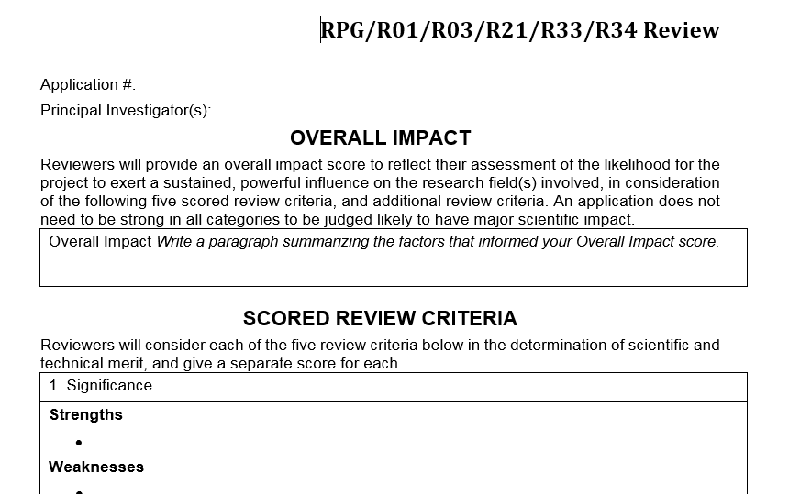
Written Critiques
Five Scored Criteria
Other Criteria
Overall Impact

Slide 22

Review Criteria: Overall Impact
Overall consideration for all NIH
applications
Defined differently for different
types of applications
    Research grant applications: Likelihood for the project to
      exert a sustained, powerful influence on the research
      field(s) involved

Slide 23
Types of Review Criteria
Category* | Criteria (Research) | Criterion Scores? | Affect Overall Impact Score?
Scored Review Criteria | Significance Investigators Innovation Approach Environment | Yes | Yes
Additional Review Criteria | Study Timeline (CT only) Human Subjects** Vertebrate Animals** Inclusion** Biohazards | No | Yes
Additional Review Considerations | Foreign Institutions Select Agents Resource Sharing Authentication of Key Resources | No | No
* Found in every Funding Opportunity Announcement
** If Unacceptable, award cannot be issued until resolved

Slide 24

Rigor and Transparency
Four components (*Can affect the scores):
  Scientific premise for the proposed work*
  Scientific rigor of the work proposed*
  Consideration of relevant biological variables*
  Authentication of key biological/chemical resources
Implemented for most:
  Research grant applications
  Mentored Career Development Award applications
See Rigor and Reproducibility: http://grants.nih.gov/reproducibility/index.htm

Slide 25
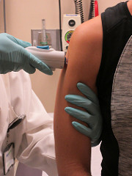
Clinical Trials
NIH initiatives to enhance the accountability and transparency of clinical research
And peer review:
  Clinical Trial-specific Funding Opportunities (FOAs)
  Clinical Trial-Specific Review Criteria
Picture courtesy of the
NIH Communications Office

Slide 26
NIH Scoring System
Reviewers give numerical scores
  1 (exceptional) to 9 (poor)
  Used for criterion scores and final impact score
Impact | Score | Descriptor
High Impact | 1 | Exceptional
 | 2 | Outstanding
 | 3 | Excellent
Moderate Impact | 4 | Very Good
 | 5 | Good
 | 6 | Satisfactory
Low Impact | 7 | Fair
 | 8 | Marginal
 | 9 | Poor

Slide 27

At the Review Meeting
    Any member in conflict with an application leaves the room.
    Reviewer 1 introduces the application and presents critique, including all score-able issues (scored criteria, human subjects protection, vertebrate animals, etc.).
    Reviewers 2 and 3 highlight additional issues and areas that significantly impact scores.
    Disagreements are discussed,
    clarified
Picture courtesy of the
NIH Center for Scientific Review

Slide 28

At the Review Meeting
Continued…
      Chair summarizes.
    Assigned reviewers provide final scores (setting range).
    All members provide final scores privately (if voting out of range, rationales are given).
    Non-score-able issues discussed: budget, data sharing plan, foreign applications, etc.
Picture courtesy of the
NIH Center for Scientific Review

Slide 29
Final Impact Scores
Each member votes based on discussion
Not just assigned reviewers
Voted by private ballot at the meeting
Final Impact Scores range from 10 through 90
Calculated by averaging all reviewers’ scores and multiplying by 10
Percentiled for some mechanisms
90 – Lowest Impact
10 – Highest Impact

Slide 30
Streamlining Applications
Allows discussion of more meritorious applications
  Less meritorious applications
    Not discussed at the meeting
    Designated “Not Discussed” (ND)
ND requires full concurrence of the entire study section
ND
Scored

Slide 31
After the Review
eRA Commons (https://public.uat.era.nih.gov/commons)
    Final Impact Score within 3 days
    Summary statement available within 4 – 8 weeks to:
        Funding Institute Program Officer
        PD/PI
        Other NIH Officials
        Advisory Council members

Slide 32
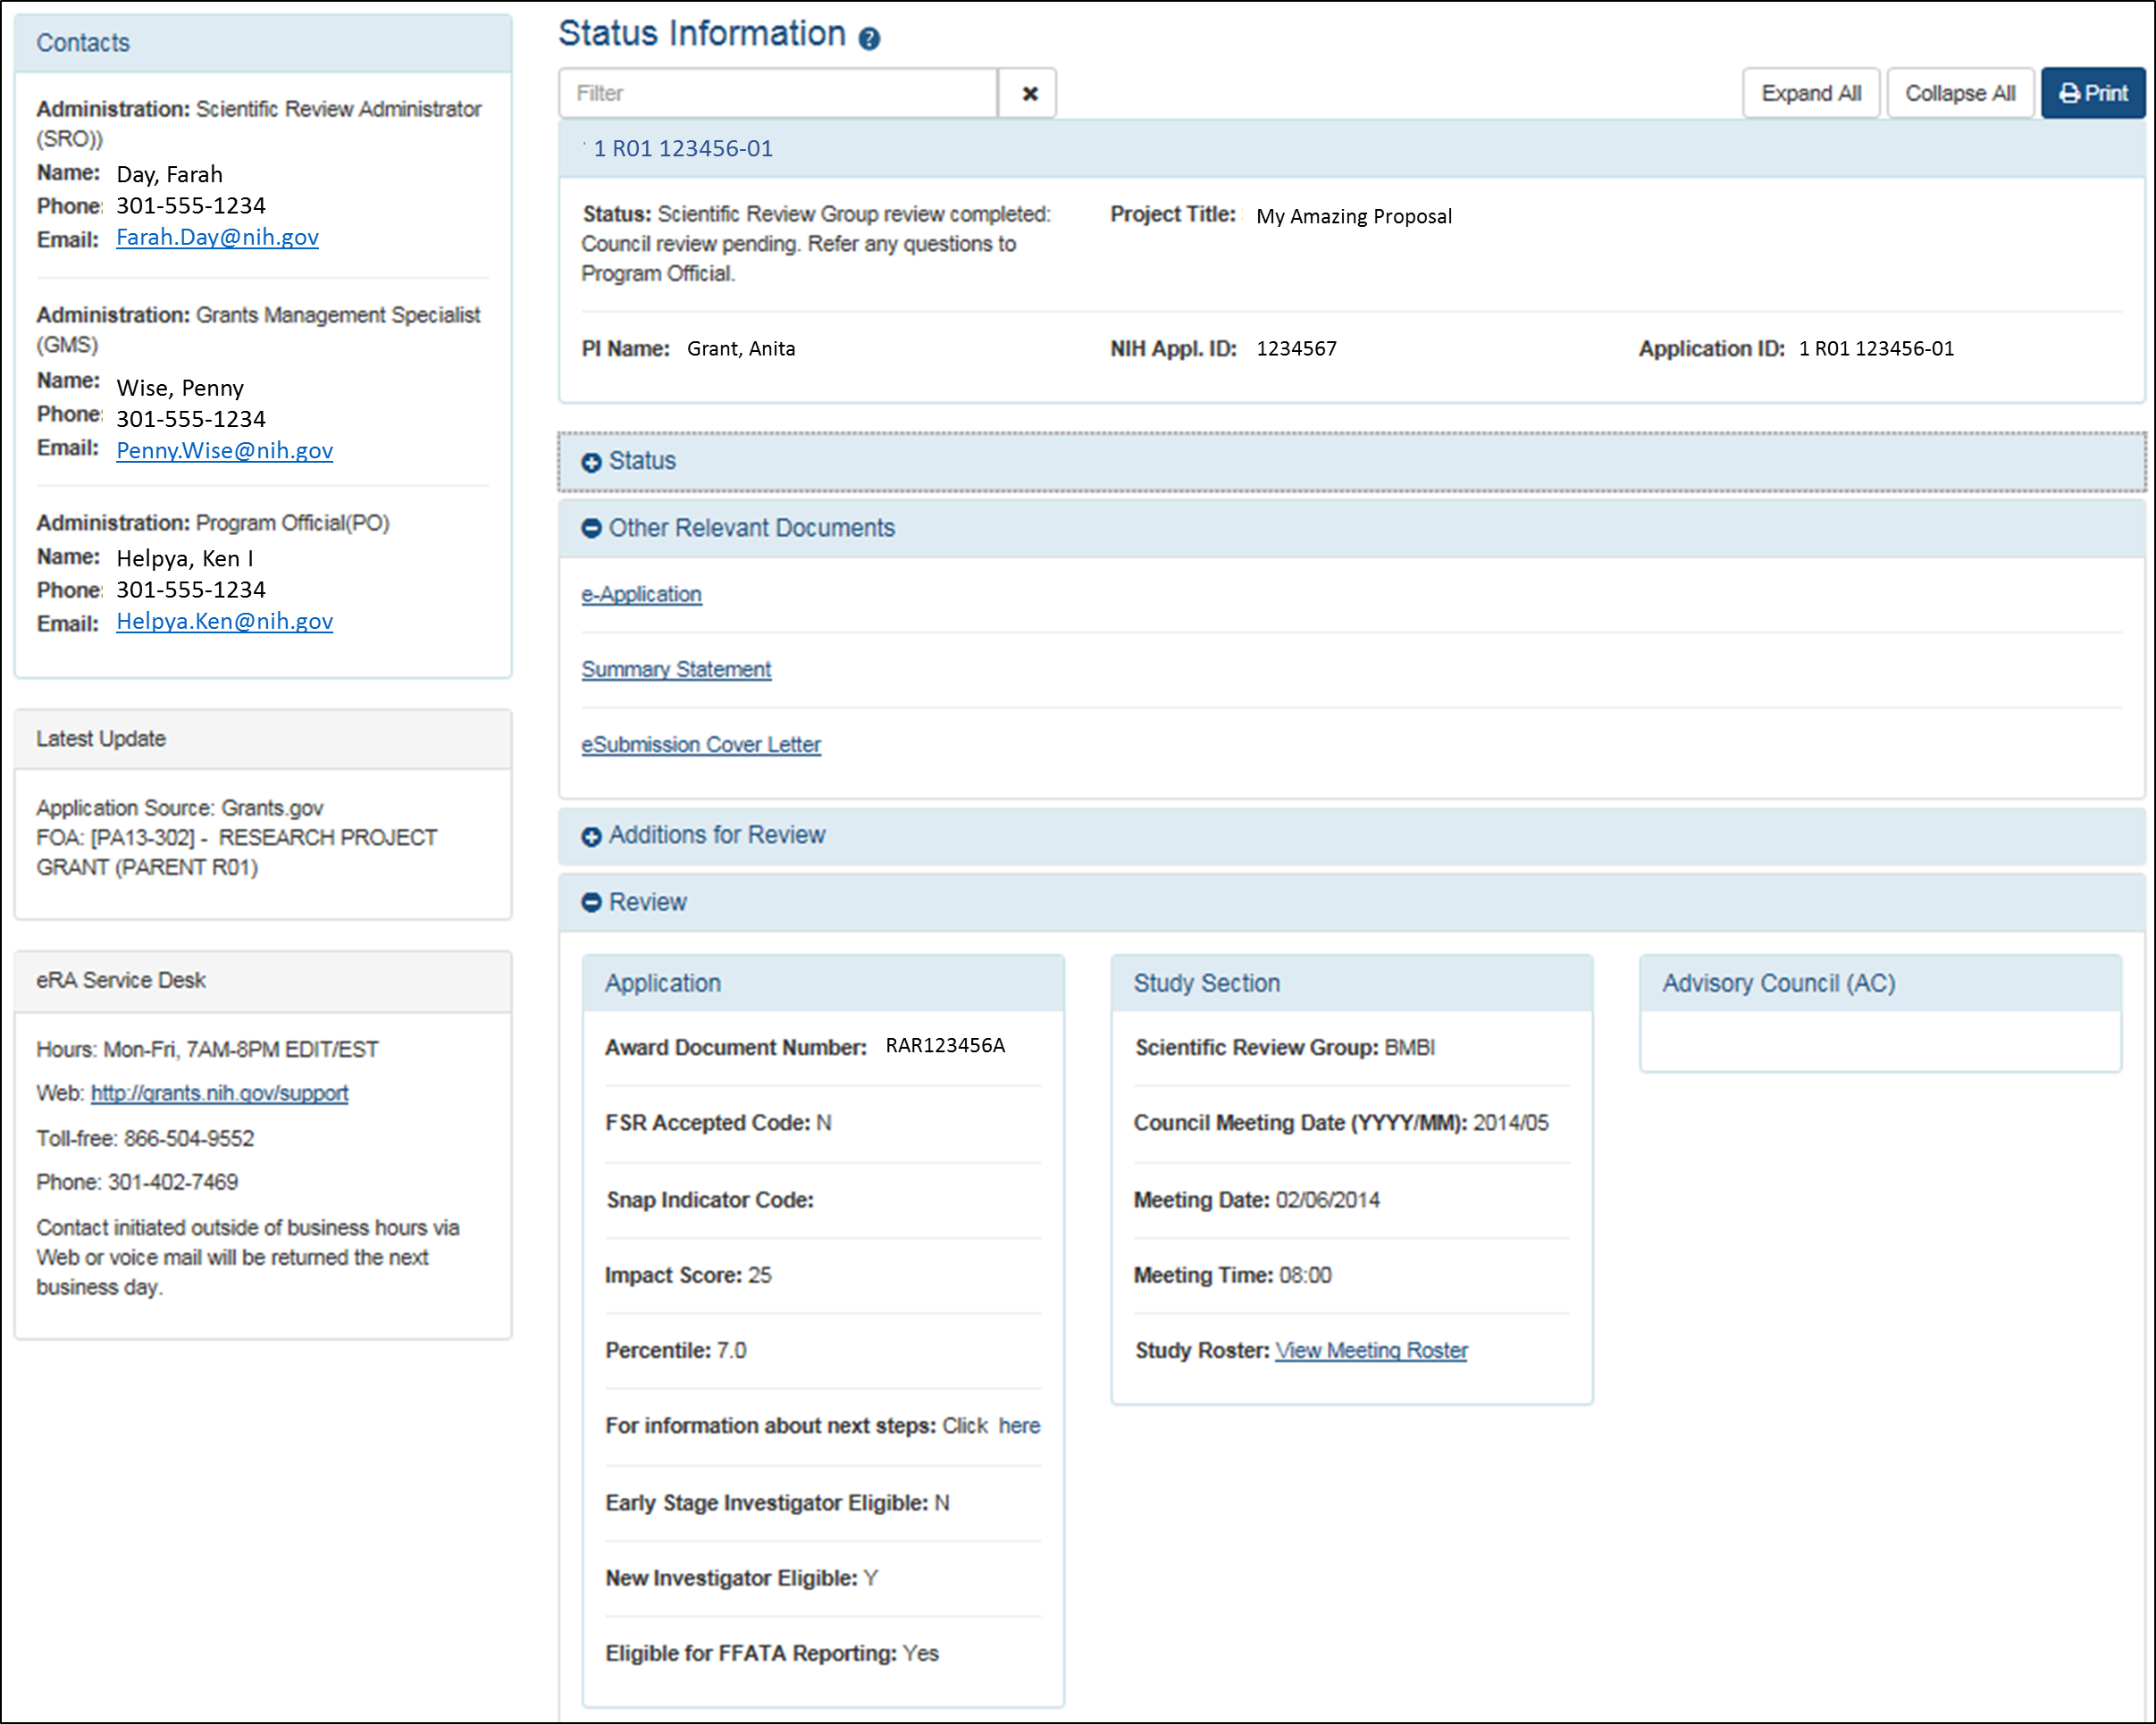
Check Application Status in the eRA Commons

Slide 33
Summary Statement
Summary statements contain:
    Reviewer critiques
    Criterion scores
First page
  NIH Program Official (upper left corner)
  Final Impact Score or other designation
  Percentile (if applicable)
  Codes (human subjects, vertebrate animals, inclusion)
  Budget request
A favorable score does not guarantee funding!

Slide 34

Summary Statement - continued
Subsequent Pages
          Resumé and Summary of Discussion (if discussed)
          Description (provided by applicant)
          Criterion scores from assigned reviewers
          Reviewer critiques – essentially unedited
          Administrative Notes
          Meeting roster
Picture courtesy of the
NIH Center for Scientific Review

Slide 35

After the Review Meeting
  Your point of contact is the assigned NIH
  Program Official.
  You may need to:
      Submit Just-in-Time (JIT) information
      Resolve human subject, vertebrate animal, inclusion codes
    Consider your options:
          Submit a new application
          Revise and resubmit your application
          Appeal the review outcome (NOT-OD-11-064)

Slide 36
Level 2 of NIH Peer Review: Councils
Key Decisions:
    Funding recommendations
    Program priority
Funding Institute(s)
Scientific Review Group
Initial Review Groups (CSR or ICs)
Scientific Focus & Mission Relevance
Program Officials (POs)
Scientific Review Officers (SROs)
DRR
Council
IC
Director
Application

Slide 37

National Advisory Councils
  Broad and diverse membership
            Basic/research scientists
            Clinician scientists
            “Public” members
  Awards cannot be made without Council approval
  Council procedures vary across IC’s
  Council is chaired by Institute Director, advised by IC extramural research staff

Slide 38

National Advisory Councils
Advise IC Director about
      Research priority areas
      Diverse policy issues
      Concept clearance for future initiatives
      Funding priorities
Recommend applications for funding
      Expedited awards
      En bloc concurrence
Consider unresolved appeals and grievances related to initial peer review

Slide 39

Funding Decisions: IC Director
The IC Director makes the final funding decisions
Based on:
    Mission of the NIH Institute or Center
    Program priorities, Congressional mandates
    Outcome (score/percentile) of initial peer review
    Additional outside expertise, if needed
    Recommendation of IC Program Staff
    Recommendation of the IC Advisory Council
    Available Funds

Slide 40

New Considerations!
Beginning with the January 25, 2019 due date:
  Revised review criterion language
  Scientific premise
  Inclusion across the lifespan
  New Parent Announcements
  Join the Guide Table of Contents (TOC)!
  http://grants.nih.gov/grants/guide/listserv.htm

Slide 41

NIH Live Mock Study Section!
Today at 4:45 – 5:30
See typical scenarios from NIH study sections
Ask questions of NIH staff
Picture courtesy of the
NIH Center for Scientific Review

Slide 42
Additional Information
Office of Extramural Research Peer Review Process
http://grants.nih.gov/grants/peer_review_process.htm
Peer Review Policies & Practices
http://grants.nih.gov/grants/peer/peer.htm
Center for Scientific Review
http://public.csr.nih.gov/Pages/default.aspx
NIH Guide to Grants and Contracts
http://grants.nih.gov/grants/guide/index.html
NIH RePORTER Matchmaker https://projectreporter.nih.gov/reporter_matchmaker.cfm

